Slide 1
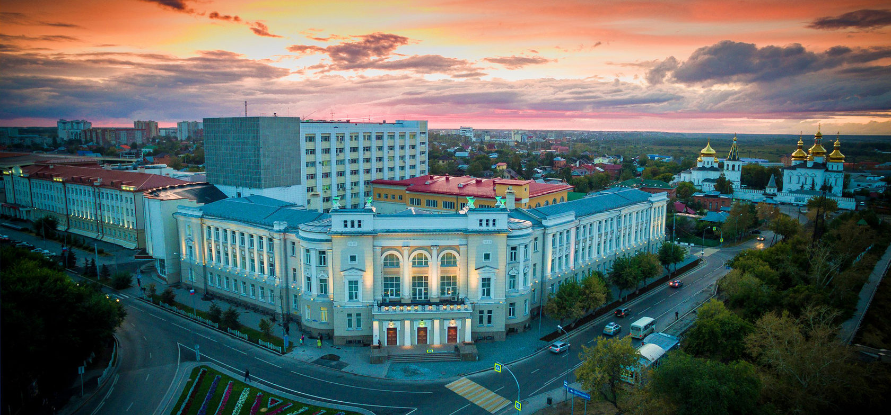
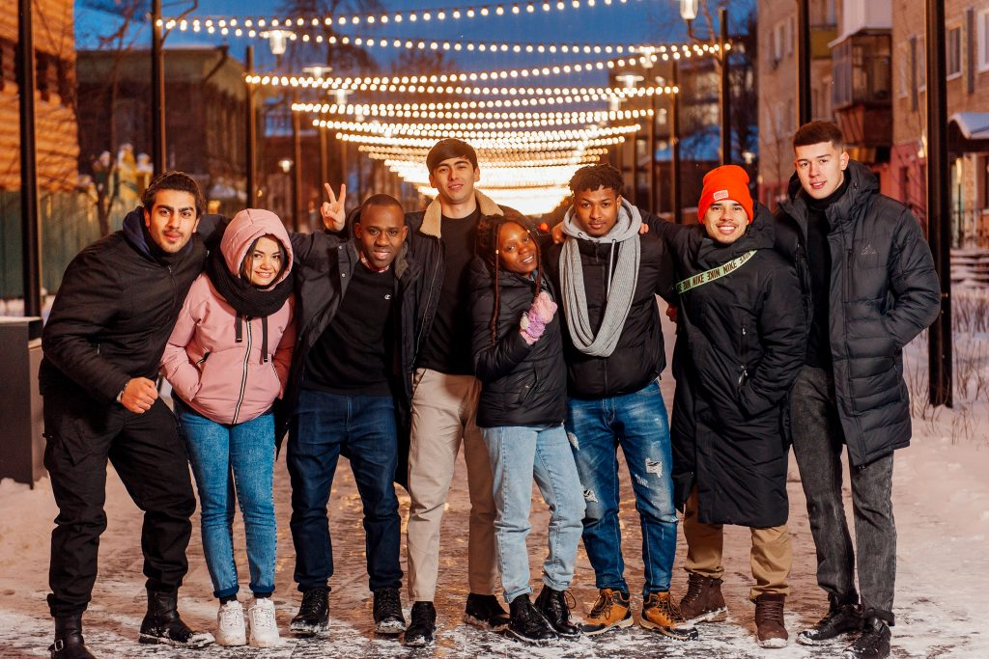
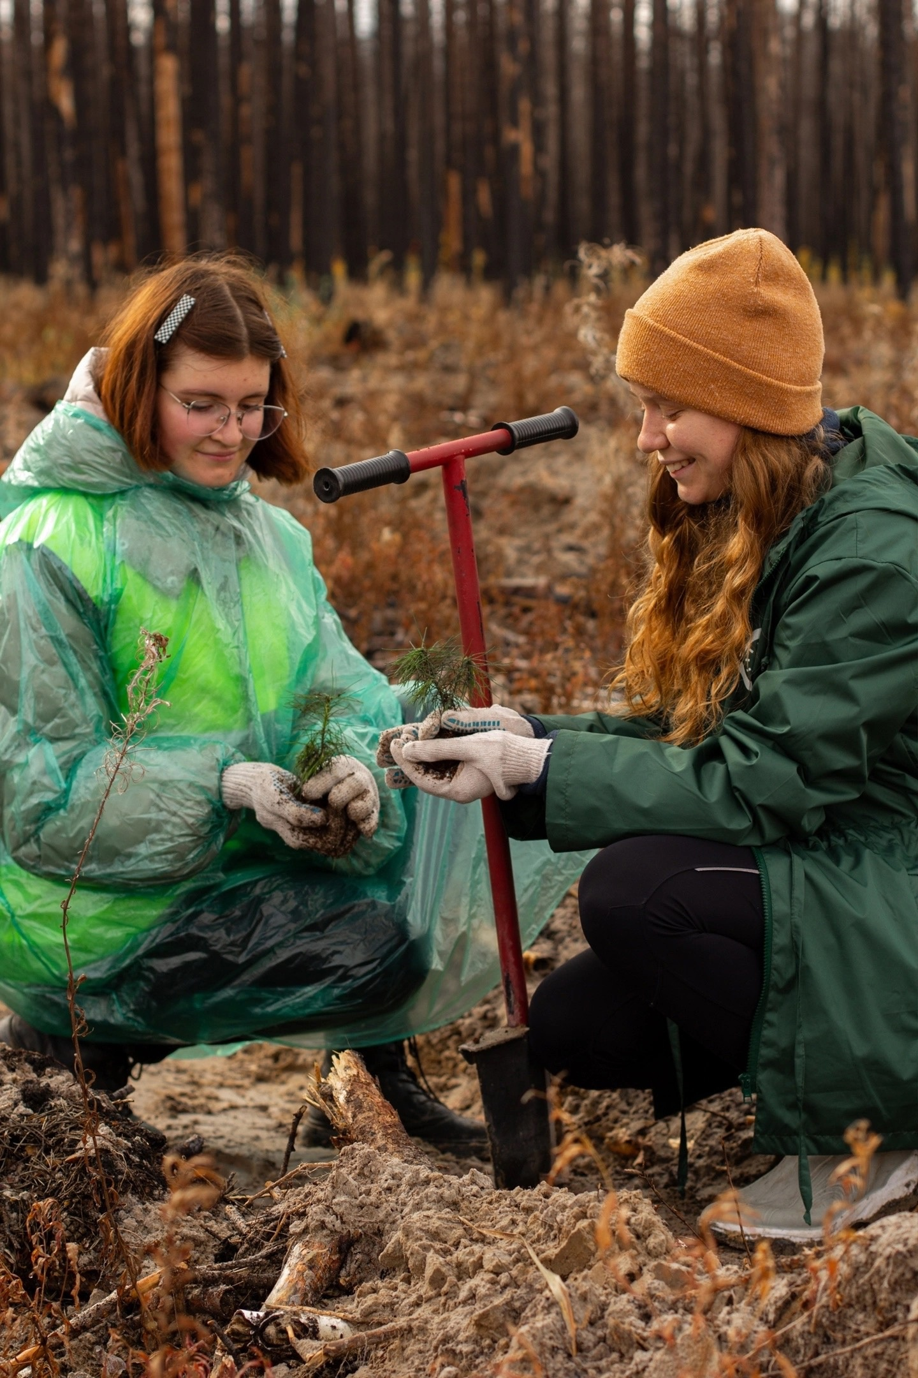
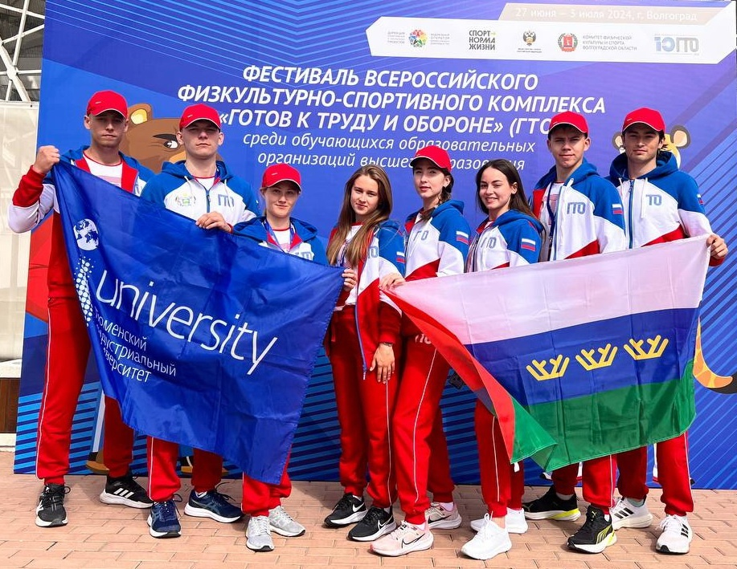
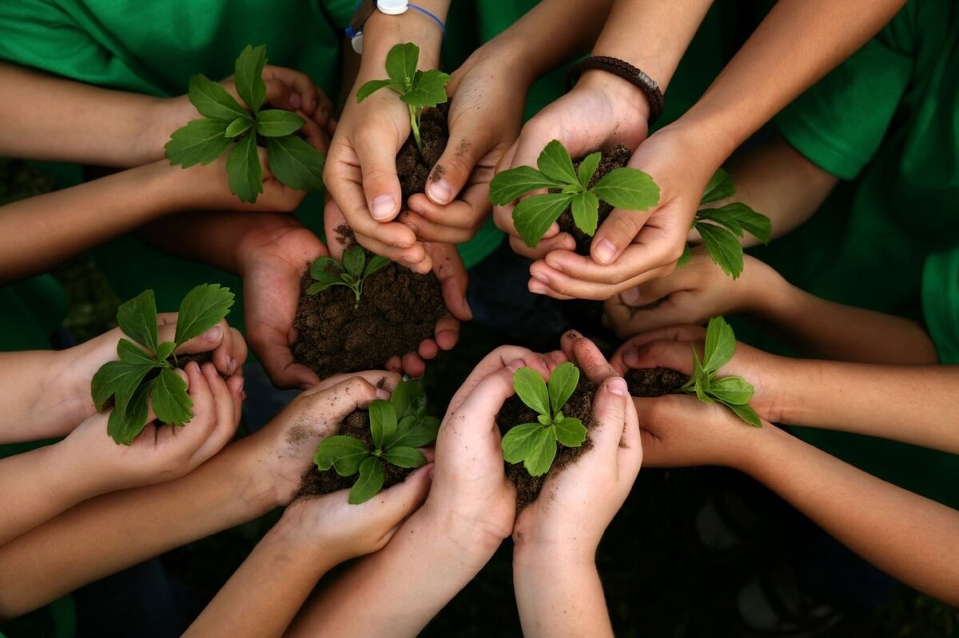
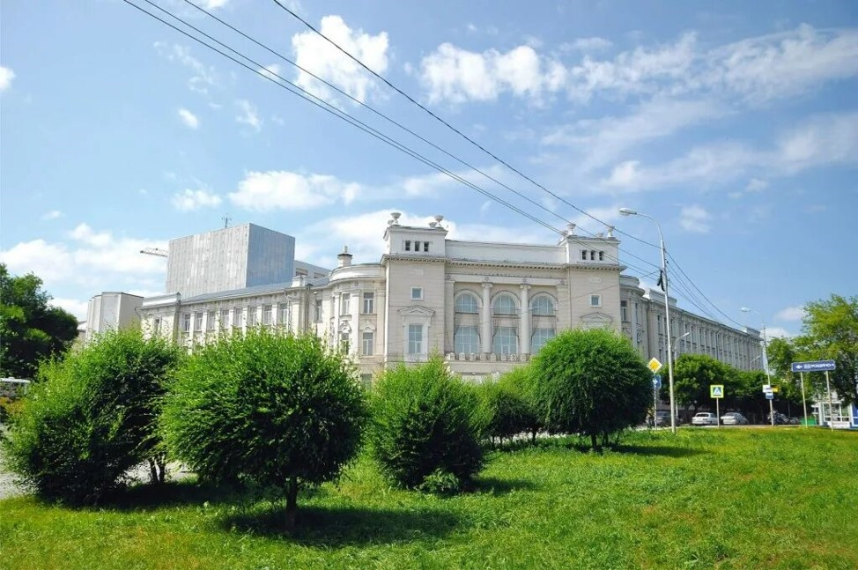
SUSTAINABILITY REPORT
INDUSTRIAL UNIVERSITY OF TYUMEN
2023

Slide 2
CONTENTS
About the university
3
SDG 1 No poverty
4
SDG 2 Zero Hunger
6
SDG 3 Good health and well-being
8
SDG 4 Quality education
11
SDG 5 Gender equality
18
SDG 6 Clean water and sanitation
25
SDG 7 Affordable and clean energy
27
SDG 8 Decent work and economic growth
29
SDG 9 Industry, innovation and infrastructure
34
SDG 10 Reduced inequalities
40
SDG 11 Sustainable cities and communities
43
SDG 12 Responsible consumption and production
47
SDG 13 Climate action
50
SDG 14 Life below water
52
SDG 15 Life on land
54
SDG 16 Peace, justice and strong institutions
56
SDG 17 Partnerships for the goals
58
Contact Information
63
SUSTAINABILITY REPORT INDUSTRIAL UNIVERSITY OF TYUMEN 2023
2

Slide 3



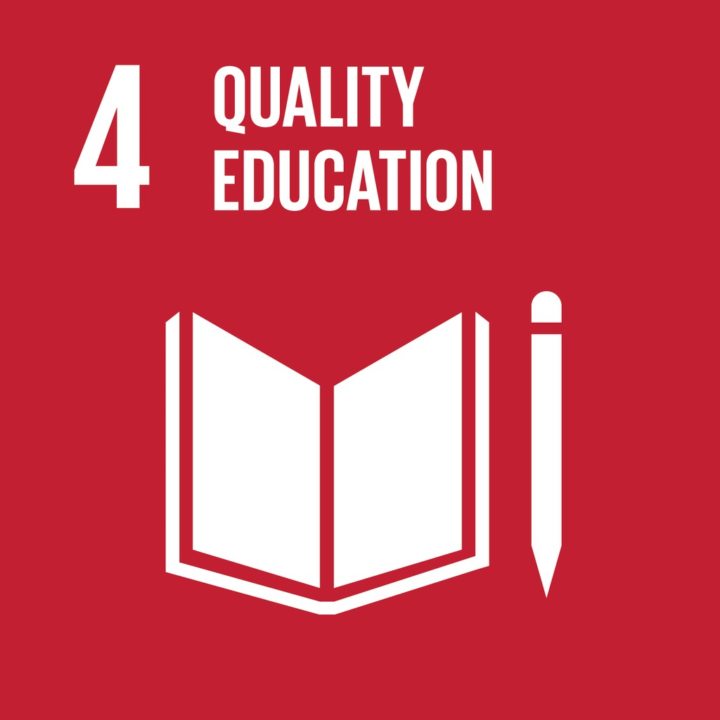






























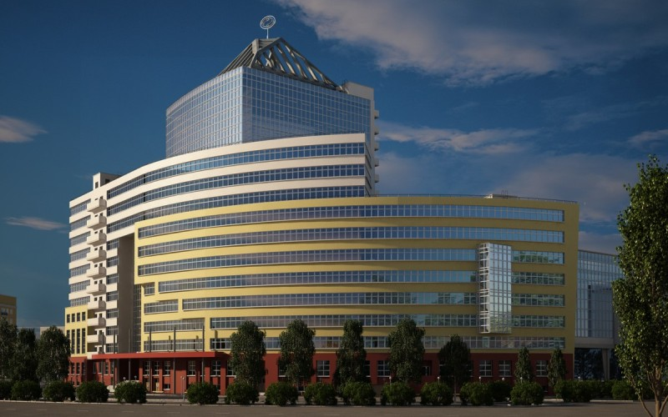

About the university
1956
year the university was founded
1
Higher Engineering School
1
Higher School of Digital Technologies
7
institutes
4
branches
1
Multidisciplinary College
1
General Education Lyceum
58
departments
9
basic industrial departments
26
scientific laboratories
26,000+
students
5
levels of education
1000+
academic staff
140+
educational programs in the field of sustainable development
2
programs in English
100+
publications in the field of sustainable development
6,8% international full-time students
39 recruiting countries
50
foreign partner universities
85%
of graduates work in more than 40 regions of Russia, 45 neighboring CIS countries and far abroad
SUSTAINABILITY REPORT INDUSTRIAL UNIVERSITY OF TYUMEN 2023
3

Slide 4



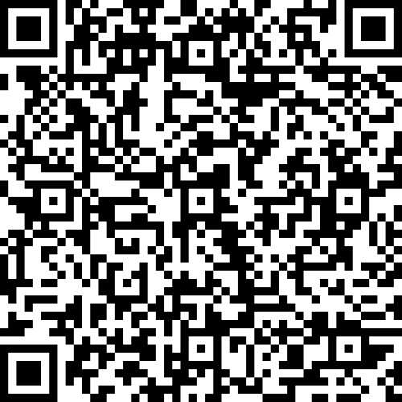
1
>13
3500+
publication
million rubles – financial assistance to students
students receiving financial assistance
SUSTAINABILITY REPORT INDUSTRIAL UNIVERSITY OF TYUMEN 2023
4

Slide 5
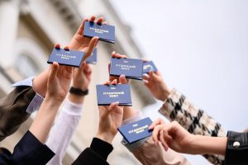
The following financial support measures are available for students at Industrial University of Tyumen:
Scholarships: state academic scholarship is awarded for academic performance; increased scholarship – for high achievements in academic, research, social, cultural, creative and sports activities; personal scholarships – grants from the President of the Russian Federation (for high achievements at the all-Russian level), scholarships from industrial partners (OOO Gazprom Dobycha Yamburg, PAO Surgutneftegas, PAO Transneft, etc.), scholarships for first-year students studying on a fee-paying basis – for high scores on the Unified State Exam).
Social payments: social scholarships – paid to the determined categories of citizens (orphans, disabled people, war veterans, victims of radiation disasters, etc. in accordance with Article 36 of the Federal Law "On Education in the Russian Federation" dated 29/12/2012 No. 273-FZ); one-time financial assistance to students who find themselves in a difficult life situation.
Public transport discounts: 50% for public transport, 50% for commuter train tickets, 25% for long-distance train compartment tickets.
Discounts in shops, cinemas, theatres, gyms, water parks, reimbursement for paid publication of peer-reviewed articles (for members of the United Trade Union Organization).
Financial measures of additional support for employees of Industrial University of Tyumen:
Social support (one-time financial assistance to employees and non-working pensioners; one-time financial assistance to employees upon dismissal owing to retirement; one-time payments to young research fellows and teaching staff related to the faculty; compensation of part of the costs of travel to the place of work by public transport, for educational services, etc.).
Financial assistance upon written application of employees (in cases of incurred financial costs related to thefts, fires, disasters, man-made accidents and other unforeseen circumstances; in case of death of a close relative; in the case of an anniversary; for unbroken record of service; for single parents and parents with three or more children; in the case of the birth of a child, etc.).
Retaining the level of remuneration for teaching staff whose qualification category expired while they were on maternity leave until the child reached the age of three, taking into account the existing qualification category for the period of preparation for certification (but not more than a year after leaving the said leave).
By decision of the commission for the transition of students from paid to free education, chaired by the rector, 87 students of the Industrial University of Tyumen were transferred to budget-funded education following the academic progress of the summer examination period. Students become entitled to transfer from paid education to budget-funded education in the case of absence of academic, financial debts and disciplinary sanctions.
SUSTAINABILITY REPORT INDUSTRIAL UNIVERSITY OF TYUMEN 2023
5

Slide 6

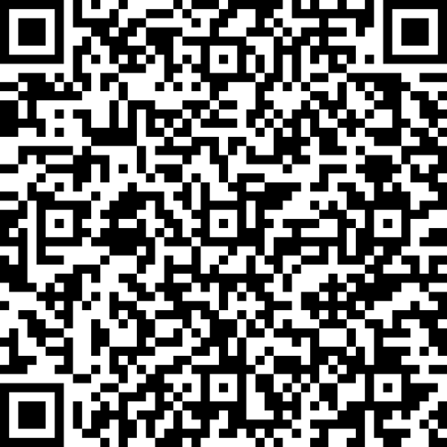
1
888
publication
students receive food benefits
SUSTAINABILITY REPORT INDUSTRIAL UNIVERSITY OF TYUMEN 2023
6

Slide 7
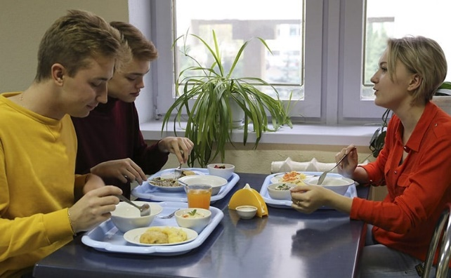
At the food supply facilities of Industrial University of Tyumen there is an opportunity to choose environmentally healthy food products. Hot meals are provided; a twelve-day menu has been developed taking into account daily calorie intake, including vegetarian dishes. The selection of suppliers of healthy food products is made in accordance with the technical regulations of the Customs Union and is based on the principles of HACCP.
In IUT, the purchase of food products is carried out in compliance with the requirements and procedure for concluding contracts established by Federal Law No. 44-FZ of April 05, 2013 «On the contract system in the field of procurement of goods, work, services to meet state and municipal needs», Regulations on procurement.
In order to improve the social security of employees, the university, within the framework of the social safety net program, provides support in terms of subsistence remuneration during working hours.
Volunteers of the Industrial University of Tyumen worked at the #WEARETOGETHER Assistance Headquarters to sort and transport collected humanitarian aid for residents affected by forest fires in the Tyumen region.
SUSTAINABILITY REPORT INDUSTRIAL UNIVERSITY OF TYUMEN 2023
7

Slide 8



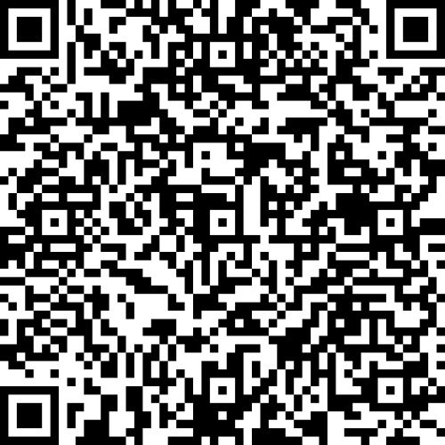
3
7
350+
programs of higher professional education
publications
sports and physical training activities
1
20,000+
program of secondary vocational education
event participants from among the University students, faculty and staff
7
programs of additional professional education
SUSTAINABILITY REPORT INDUSTRIAL UNIVERSITY OF TYUMEN 2023
8

Slide 9
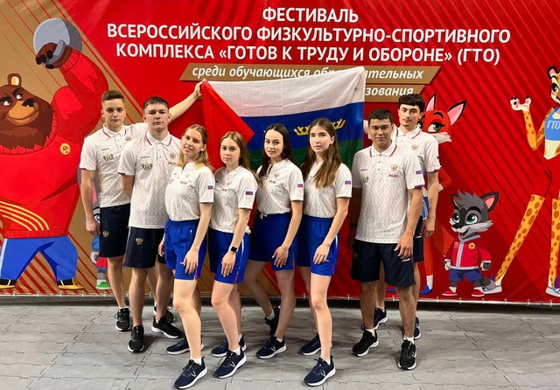
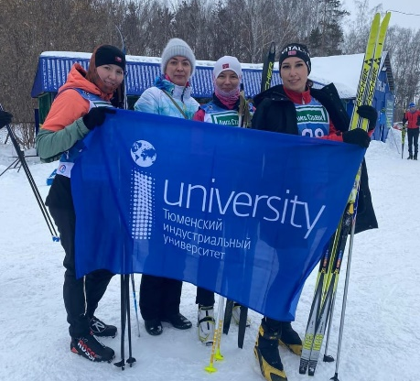
For many years, Industrial University of Tyumen has had an effective Collective Agreement, according to which employees and their families receive additional benefits and guarantees. There is also a social safety net programs, within which each employee can take advantage of a social package of his choice. Among the set of guarantees are voluntary medical insurance, additional leave, sanatorium-resort treatment, payment for travel to a place of recreation, compensation for services in sports organizations and others.
A medical center (branch of City Polyclinic No. 3 of Tyumen) has been organized on the premises of the university, which provides primary care to students and employees. The following specialists are available: therapists, ophthalmologist, neurologist, and gynecologist. You can also get psychological aid at the university. You can sign up for an in-person appointment, or call the Helpline (help is provided around the clock, anonymously and free of charge).
On a regular basis, IUT holds events (seminars, voluntary events, motivational publications, curatorial hours, etc.) aimed at preventing illness among students and teachers.
In order to promote a Healthy Lifestyle (HLS), IUT organizes on-site events at the Olympia sports and recreation center (skiing and slides, sports competitions and many other outdoor activities).
Students of the Institute of Service and Industrial Management, under the scientific supervision of a teacher of the Department of Marketing and Municipal Management, took 1st place at the All-Russian Festival-Championship of Media Volunteering #DobroMedia in the nomination "Advertising Campaign for Stroke Prevention". To implement the project on stroke prevention, the students chose the social network "VKontakte", which has a wide audience reach. The main focus is on stimulating users to take preventive measures against the disease.
The university team became entitled to represent the Tyumen Region in the final of the All-Russian festival "Ready for Labor and Defense" (hereinafter - GTO). The final competitions were held in the format of individual-and-team scoring. The team of the Industrial University of Tyumen took 5th place among 39 teams, scoring 4,216 points.
Industrial University of Tyumen took the fourth place in the team scoring at the 59th Sports and Athletic Contest of teachers, researchers and employees "Friendship", organized by Tomsk Polytechnic University. Regarding the results of drawing, the university took over the helm of "Friendship" and will host the competition next year. The Sports and Athletic Contest was attended by 250 teachers, employees and researchers from 11 universities of Tomsk, Yekaterinburg, Tyumen, Novosibirsk, Kemerovo, Magnitogorsk, Kurgan and Chelyabinsk. For four days, they competed in individual and team championships in seven sports, as follows: volleyball, table tennis, badminton, cross-country skiing, swimming, GTO all-around and chess.
SUSTAINABILITY REPORT INDUSTRIAL UNIVERSITY OF TYUMEN 2023
9

Slide 10
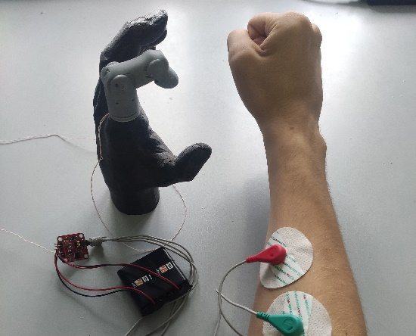
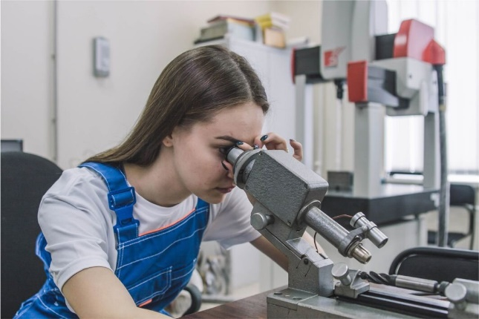
For over 20 years, the Industrial University of Tyumen has been developing the Biotechnical Systems and Technologies educational program, where future medical engineers are trained. Unique specialists are engaged in the development of new medical equipment and its maintenance. Graduates have a 100% employment guarantee. The future employees are welcome in medical and technical centers, design bureaus for the production and maintenance of medical equipment. The department has unique laboratories equipped with a modern computer tomograph, equipment for the study and repair of electronic devices. For example, this year, first-year students worked on such projects as the development of a hardware and software complex for diagnosing diabetic foot, a prototype of an upper limb prosthesis, a device for the treatment of nasal septum pathology, respiratory diseases, diagnostic technology for pathology of the human nervous system, a prototype of an eye prosthesis, as well as the modernization of an electronic patient medical record. Students and graduates of the program are confident that based on their efforts they save patients' lives and improve their quality of life like doctors.
Academics and students of the Department of Commodity Science and Food Technology create useful food additives for the prevention of gastrointestinal diseases. For this purpose, scientists have designed a synbiotic consisting of prebiotics and probiotics. The finished substance is planned to be added to confectionery products with reduced calorie content. As raw materials, specialists use callus masses obtained by the in vitro method from the leaves of lingonberry and calendula growing in the Arctic territories. They contain a significant amount of glycosides, allowing a person to remain healthy, energetic and protected from the development of gastrointestinal disorders.
A student of the Institute of Industrial Technology and Engineering has developed a bionic finger prosthesis, which has no analogues on the domestic market. The prototype has more functionality, which was achieved through electronics. The student received a grant in the Student Startup competition to implement the project. At the moment, there is already a prototype printed on a 3D printer. In the future, the prosthesis will be made of metal with titanium alloy elements.
The Industrial University of Tyumen summed up the results of the student research projects competition on the topic "Healthy Nutrition - Healthy Nation". Future technologists not only told about their best developments, but also held a tasting of specialized products. The scientific and practical conference, within the framework of which the competition was held, is one of the oldest traditions of the Department of Commodity Science and Food Technology. During the year, students studied Russian and world experience, designed specialized health-preserving products themselves, participated in scientific events of various levels with the manufactured prototypes and became winners. The authors of the projects showed how to make food products functional, i.e. having a beneficial physiological effect on certain systems of the human body.
SUSTAINABILITY REPORT INDUSTRIAL UNIVERSITY OF TYUMEN 2023
10

Slide 11
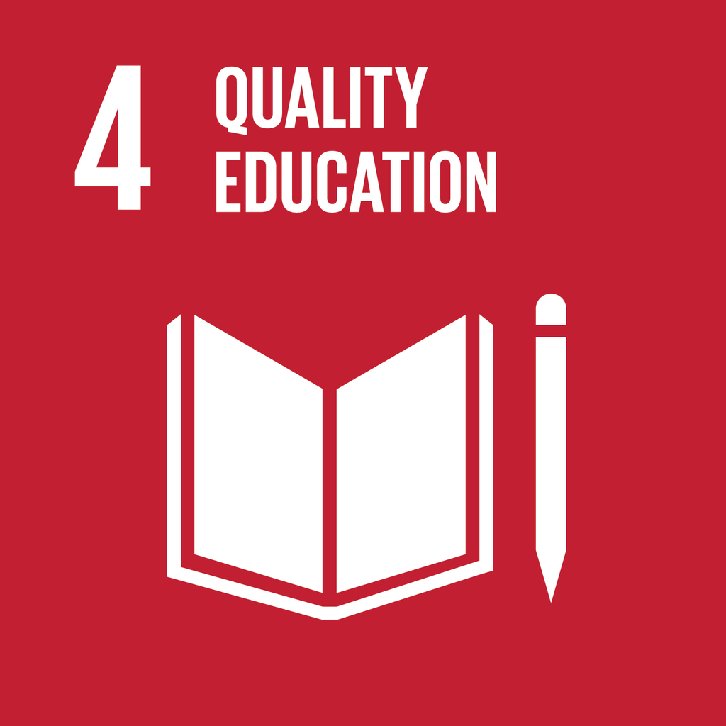


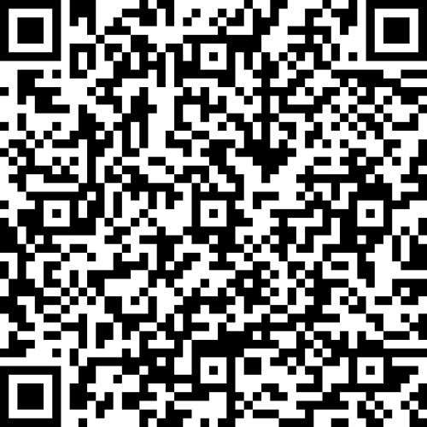
31
37
5
higher education programs have passed professional and public accreditation
best educational programs of the innovative Russia
programs of higher professional education
14
8
3
additional education programs have passed professional and public accreditation
publications
programs of additional professional education
6
programs have certificates of compliance with international accreditation
SUSTAINABILITY REPORT INDUSTRIAL UNIVERSITY OF TYUMEN 2023
11

Slide 12
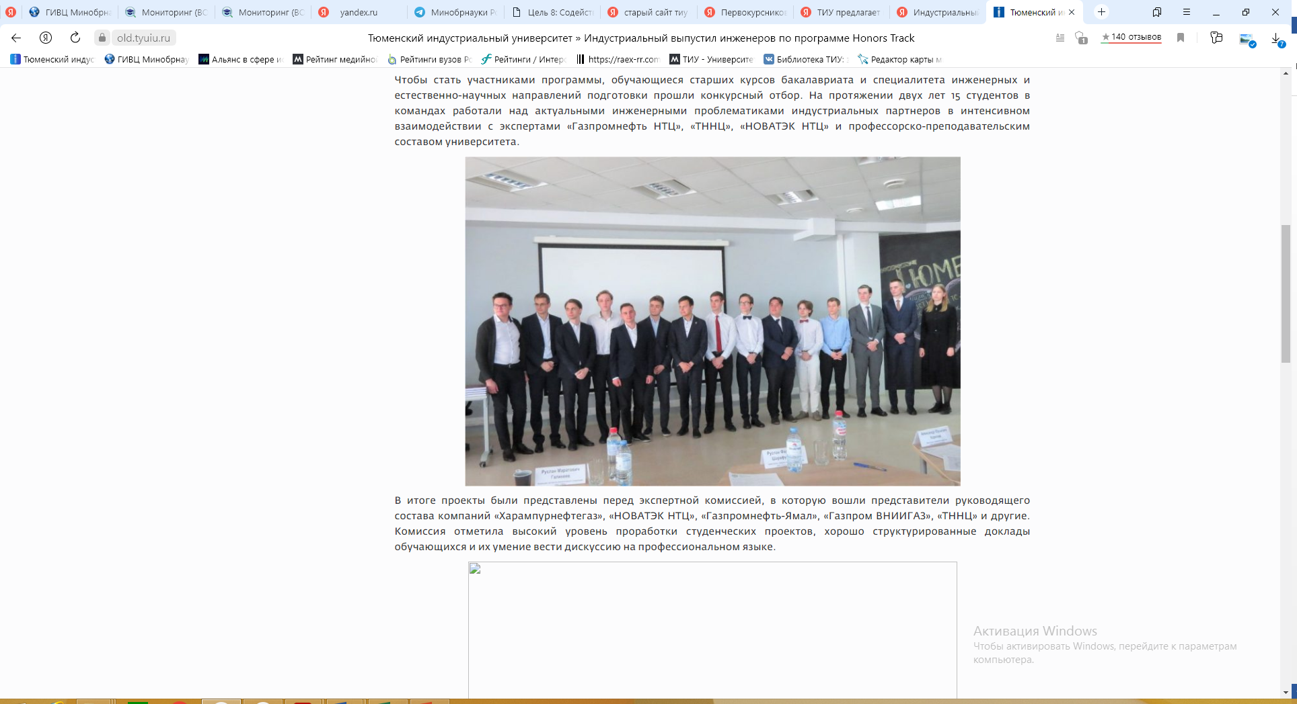
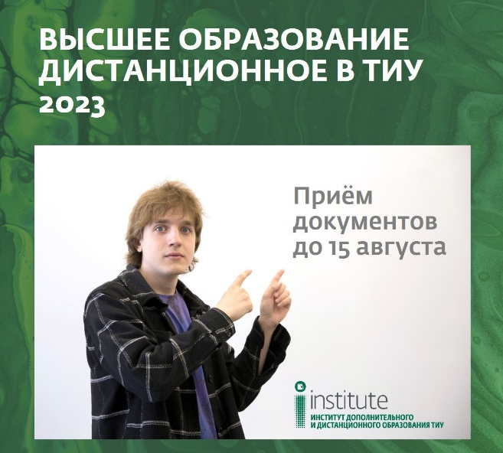
Industrial University of Tyumen received a certificate of participation in an independent assessment of the quality of education in the project "Improvement and implementation of the model for independent assessment of the quality of training of students in higher education institutions", conducted by the Federal Service for Supervision in Education and Science. The project assessed the degree of formation of general professional competencies of final-year students in four majors, as follows: 08.03.01 Construction, 09.03.01 Informatics and computer engineering, 20.03.01 Technosphere safety and 23.03.03 Operation of transport and technological machines and complexes. 90 students took part in the testing, more than 85% of future graduates successfully completed the tasks and confirmed the quality of training.
At the Institute of Continuing and Distance Education, one can remotely (on-the-job or without interrupting studies) obtain higher education (length of study: from 2.5 to 6 years), a trade job (length of study: several weeks), as well as undergo professional retraining (length of study: several months) and top up qualifications (length of study: several weeks). The Institute offers more than 300 programs that meet the challenges of the time and the requirements of the modern labor market. For the convenience of students, modern video lectures and electronic materials from highly qualified academics and leading experts, as well as virtual simulators where one can train practical skills, have been arranged.
The EG Higher Engineering School of the Industrial University of Tyumen is implementing the Honors Track - PBL and Digitalization in the Field of Development and Operation of Oil and Gas Fields Professional Retraining Program. The project is aimed at training engineers and inventors who are capable and focused on teamwork on current problems in the oil and gas industry. Program participants get a unique opportunity to establish close contact with representatives of the oil and gas industry, undergo an internship at a partner company, and combine training with the main educational program.
The Institute of Continuing and Distance Education is the only one in the Tyumen Region that trains specialists under the Presidential Program for the Training of Management Personnel. Great opportunities open up for program participants: internships in leading Russian and foreign companies, accession into the federal and regional personnel reserve, membership in the community of young and advanced managers of the Regional Association of Graduates of the Presidential Program of the Tyumen Region.
In 2023, the university won a grant competition within the framework of the "Professionalitet" federal project of the "Education Development" state program of the Russian Federation. In this regard, the Educational and Production Center "M-Tech" was created on the basis of the Multidisciplinary College, where personnel are trained in popular, promising vocational professions and specialties in the mechanical engineering industry. "M-Tech" is a single platform for interaction between leading enterprises in the oil and gas engineering industry.
SUSTAINABILITY REPORT INDUSTRIAL UNIVERSITY OF TYUMEN 2023
12

Slide 13
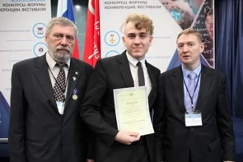
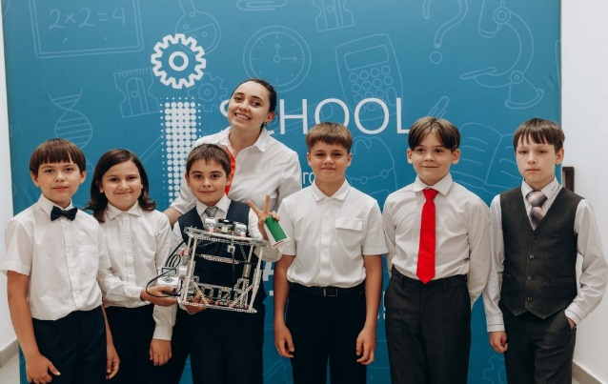
The Industrial University of Tyumen has an Engineering Reserve School (ERS), which is attended by almost a thousand of children. The main focus of work with schoolchildren of all ages is project activities, within the framework of which the children under the guidance of a mentor-teacher develop applications, games, websites, create voice assistants with artificial intelligence, and assemble electric bikes, quadcopters, fire robots and much more. In addition, they try to solve the problem of launching a project into small-scale production and receiving a attributable profit. At the end of the school year, projects are defended in front of a jury, which includes representatives of the university and large industrial partners. As part of academic training, children receive in-depth knowledge of general education disciplines (mathematics, physics, computer science, chemistry), analyze non-standard problems and look for their own approach to solving them. In 2023, ERS introduced petroleum engineering as a new subject. It will allow schoolchildren to get acquainted with a promising industry and, possibly, with a future profession. Olympiad training, which is conducted in mathematics, physics and computer science, helps to reveal abilities and talents.
Extracurricular activities are an important part of the life of ERS students. Cultural and leisure activities, tours to partner enterprises are regularly held for them.
A student of the Multidisciplinary College of the Industrial University of Tyumen received a first-degree diploma in the field of Technology and Technical Creativity in National Treasure of Russia, the competition of achievements of talented youth. 475 people from all over the country took part in the in-person stage. The mentioned student won for his research work "Utilization of associated petroleum gas". The jury of the competition appreciated the student's idea of ​​building a plant for cleaning associated petroleum gas and producing polyethylene from it.
In 2023, as part of the state final certification, 14 exams were held at the university and 160 graduates of the Multidisciplinary College, and 24 of them in the branch in Noyabrsk were certified. Independent experts from among industrial partners with official and recognized qualifications in the represented field were involved in assessing the results. Among the 50 experts were representatives of the companies, as follows "Zavod ZHBI-3", "ENKO Invest", "TDSK", "Tyumengaz", "UGMK Elektrostal Tyumen", "Rosseti Tyumen", "Sibburmash", "Tyumen motorostroiteli" and others. At large the expert groups acknowledged the high level of practical training of graduates. Based on the results of the demonstration exams, 86 students made out with the task and gained excellent marks, 56 received a "good" mark, 42 received a "satisfactory" mark. The demonstration exam format gives students the opportunity to present their knowledge and skills in practice, receive an independent assessment of their work and experience in business communication with potential employers. In addition to the fact that the results of the demonstration exam will be reflected in the graduates' diplomas, each participant will receive a digital competency passport, which can be shown for an employer to increase chances of employment.
SUSTAINABILITY REPORT INDUSTRIAL UNIVERSITY OF TYUMEN 2023
13

Slide 14
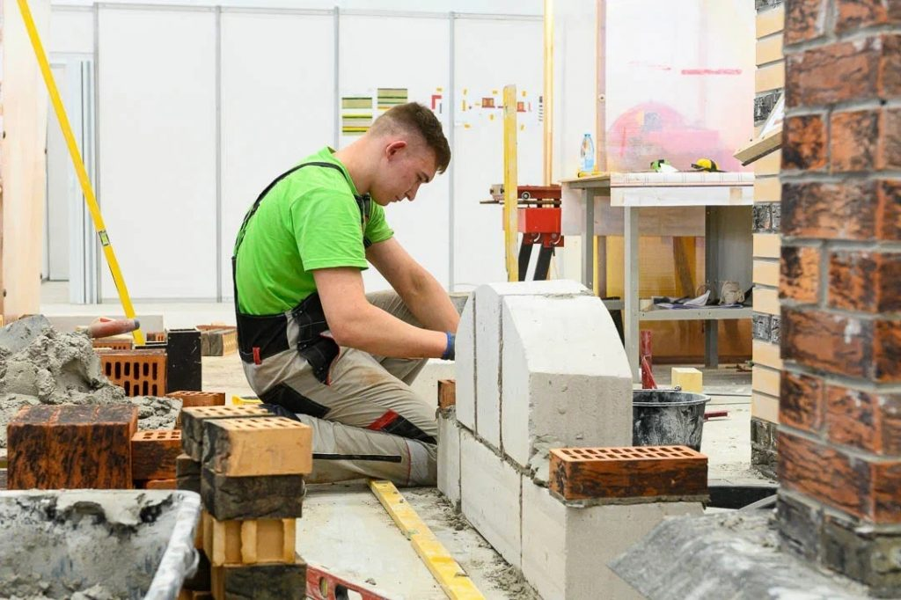
Students of the Multidisciplinary College and Lyceum, who represented Industrial University of Tyumen at the regional stage of the Professionals Championship in Professional Skills - Tyumen Oblast 2023, were awarded gold, silver and bronze medals in 8 competencies. 50 educational institutions took part in the championship, 495 contestants competed for the title of the best in 86 competencies. The new concept of the championship movement is aimed not only at popularizing nonprofessional occupations, but also at interacting with industrial partners, as well as training target personnel. Therefore, all competition tasks were adapted to the needs of practic employers. More than 65 organizations became partners of the championship. Winners and prize-winners were given the opportunity to undergo an internship at enterprises, and some were offered employment.
Since 2019, the university has been implementing an innovative educational format for higher education as individual educational trajectories (IET). Today, more than 4,000 people are studying following IET. An individual educational trajectory is an individual path in education that is built and implemented by the student independently. The main difference from classical education is that in addition to basic knowledge in the field of study, you can obtain an additional set of competencies that make graduates more in demand and competitive for employers. The number and list of disciplines that a student must master during the entire period of study are determined by the curriculum of the corresponding field or specialty. All applicants in 2023 entering the bachelor's and specialist's degree programs were trained according to individual educational trajectories.
Process Factory opened jointly with PAO Gazprom Neft is carrying on operating at the university. The factory facilitates students in acquiring lean manufacturing skills in the field of capital construction. The infrastructure of an oil field well pad, recreated in miniature, helps to immerse themselves in real production and practice the necessary skills. The work of the student groups takes place in close interaction and under the supervision of certified trainers, which should include specialists in capital construction, lean manufacturing, and methodologists. Currently, the Process Factory Team includes 24 certified trainers, 17 of whom are representatives of the industrial partner, 7 are from the university.
An on-site examination was conducted at Industrial University of Tyumen as part of the professional and public accreditation of the university's educational programs. The list of programs evaluated included three profiles of the Petroleum Engineering major, as follows: Drilling of oil and gas wells, Operation and maintenance of oil production facilities, Operation and maintenance of gas, gas condensate and underground storage facilities. The examination was conducted by representatives of Gazprom VNIIGAZ, Gazprom Nedra and Gazprom Central Research Station. They visited the university structural divisions, met with those responsible for organizing industrial placement for students and promoting employment for graduates of accredited educational programs, and got acquainted with the material and technical facilities. The experts highly appreciated the professionalism and competence of the program managers and teachers, noted the good material and technical and educational and methodological basic infrastructure, which contributes students to develop professional skills and abilities that meet the requirements of the modern oil and gas industry.
SUSTAINABILITY REPORT INDUSTRIAL UNIVERSITY OF TYUMEN 2023
14

Slide 15
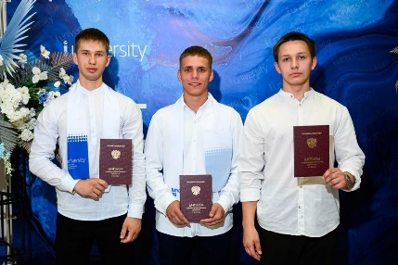
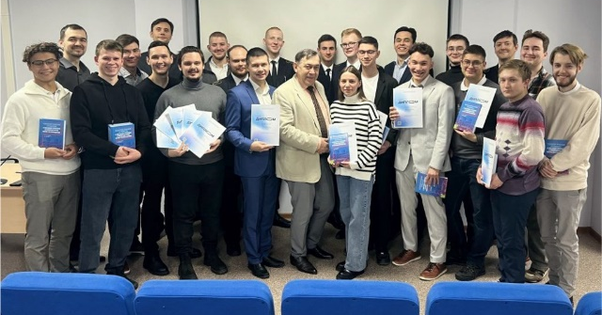
The Multidisciplinary College is one of the largest divisions of the Industrial University of Tyumen, with a student body of about 5,000 people. It unites five academic departments that train specialists in various fields. The college provides training in 30 specialties and 11 occupations of various fields and profiles. The portfolio of educational programs is updated annually. In 2023, for the first time, recruitment was made for training in the educational programs, as follows:
Environmental safety of natural complexes;
Land management;
Radio communication systems, mobile communications and television and radio broadcasting;
Equipping with automation means for technological processes and production (by industry);
Electrician of low-current systems.
In 2023, the Higher School of Digital Technologies (HSDT) was opened at the Industrial University of Tyumen. The educational process takes place in a hybrid mode, when the student masters the maximum volume of theoretical material online, then receives a practical assignment: writes a program, develops a module, structures and analyzes information. At the same time, throughout the entire process, students are supported by teachers, mentors, tutors, and representatives of enterprises. The basic subjects for HSDT students are computer science, programming, project activities, as well as applied disciplines, as follows: databases, artificial intelligence, machine learning, administration and maintenance of information systems.
A student of the Industrial University of Tyumen won the competitive selection and became a participant of the Young Personnel of the Arctic International Summer School. The training took place in St. Petersburg, organized by the State University of Maritime and Inland Shipping named after Admiral S. O. Makarov. During the week, students from Russia and the CIS countries studied the problems of the Arctic region, proposed new solutions and approaches to its development. Young people participated in trainings, business games aimed at studying the Arctic and its features, solved cases based on real events, attended lectures and practical classes, including in the Marine Training Center of the famous "Makarovka", tried themselves in the role of a ship captain and steered a yacht.
The final stage of the All-Russian Student Olympiad in the areas of Electrical Engineering and Transportation and Storage of Hydrocarbon Raw Materials was held at the Industrial University of Tyumen. Students from various universities across the country took part in the intellectual competitions.
The best results in the area of Electrical Engineering were achieved by three students from the Industrial University of Tyumen. In the team competition, IUT students became winners as well.
In the area of Transportation and Storage of Hydrocarbon Raw Materials, a student from the Industrial University of Tyumen won the individual competition. The university took second place in the team competition. Also, IUT students were recognized as the best in the Future of the Gas Industry Nomination.
The winners and prize-winners of the Olympiad received the opportunity to apply for an increased scholarship, as well as additional points when entering a master's and postgraduate program.
SUSTAINABILITY REPORT INDUSTRIAL UNIVERSITY OF TYUMEN 2023
15

Slide 16
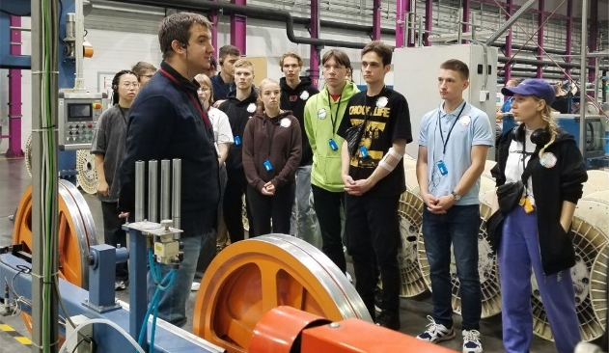
Students from the Industrial University of Tyumen completed an express internship at the largest fiber optic cable manufacturing plant in Russia and the Commonwealth of Independent States (CIS) called Incab. They were able to visit Perm Krai in the industrial tourism sector thanks to their participation in the More Than Work Federal program. Thirteen students in the Electric Power and Electrical Engineering and Applied Mathematics and Computer Science programs had the opportunity to get to know the company, immerse themselves in the work process, and see the production from the inside.
The Basic Department of AO SUENCO of the Industrial University of Tyumen is recruiting students for the Intelligent Electric Power Industry Master's program. In 2023, 15 state-funded places are open for those who want to become a multidisciplinary specialist and work in leading industry companies and design institutes from the first year of study. As part of the study of the Master's program, attention is paid to modern areas of development of the electric power industry, as follows:
Renewable energy sources
Digital electric power industry
Use of modern power electronics devices
Highly efficient energy storage systems, etc.
One of the main advantages of studying at the Basic Department is the opportunity to directly communicate with company experts and receive feedback throughout the entire training period. Graduates of the Basic Department are multidisciplinary and high-demand specialists with practical knowledge of the processes of transmission, distribution, and efficient consumption of electrical energy.
Industrial University of Tyumen was among the winners of the selection of Technologies of Personnel Sovereignty 2023 Placements Organizers, conducted by the Agency for Strategic Initiatives with two projects, as follows: Honors Track and the Center for Technological Entrepreneurship.
The selection was aimed at finding effective solutions to organize continuous professional and career development of a person in order to increase their own well-being, improve labor productivity, and develop talents. Experts evaluated the implemented practices that have proven their effectiveness and have the potential to be replicated across the country.
The IUT Honors Track project (launched at the university in 2019 for senior students; the educational process is built around the development of innovative projects that meet the current needs of the oil and gas sector) was among the best advanced engineering training programs in the nomination of Providers of Careers in Further Professional Education in the field of Further Professional Education.
The Center for Technological Entrepreneurship (created to support entrepreneurial and innovative activities of students and employees of the university) won in the nomination of Engineering and Technological Entrepreneurship in the field of Engineering Training.
A team of geophysics students from Industrial University of Tyumen won the All-Russian Student Olympiad in the complex of fundamental geological sciences and applied geology in the major of "Geophysical methods of prospecting and exploration of mineral deposits". One of the IUT students also took second place in the individual championship. The competition was attended by 825 people from 30 technical universities of Russia. Over the course of two days, the participants solved theoretical and practical problems, compiled a macro description of the core, and were engaged in the construction of maps and the analysis of indicator diagrams.
SUSTAINABILITY REPORT INDUSTRIAL UNIVERSITY OF TYUMEN 2023
16

Slide 17
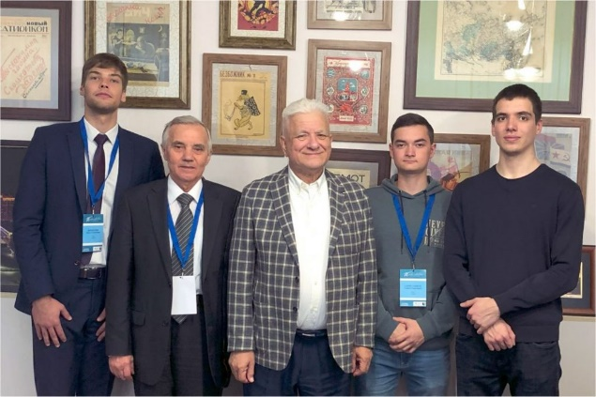
In 2023, the university opened a unique educational platform with an industry focus, the first specialized energy class in the city of Tyumen, created thanks to the cooperation of the Industrial University of Tyumen and the company AO Rosseti Tyumen. 26 lyceum students who passed the competitive selection are studying under the specialized program. The classroom is equipped with everything necessary for obtaining a high-quality education in the field of energy. Classes for students will be conducted by company employees and university teachers. The program involves in-depth training in specialized disciplines (mathematics, physics and computer science), as well as familiarization with the basics of energy and electrical safety rules, visits to enterprises, participating in industry Olympiads and competitions.
The Department of Oil and Gas Processing of the Industrial University of Tyumen provided enrollment for a new master's program, Chemical Technology of Reagents, developed jointly with OOO Gazprom Pererabotka. The program meets all the company's requirements, and its graduates will be able to work in production and scientific-practical activities at PAO Gazprom enterprises. The master's program is aimed at training specialists in the field of hydrocarbon processing with the ability to solve technological problems and improve technological processes. Upon completion of the master's program, graduates will have the opportunity to find employment at OOO Gazprom Pererabotka enterprises, as well as at PAO Gazprom subsidiaries.
Industrial University of Tyumen has joined the all-Russian FutureSkills University Project, aimed at introducing and developing best practices for training students in promising professions and skills. The project is being implemented on the initiative of the Ministry of Science and Higher Education of the Russian Federation and the Agency for the Development of Professions and Skills. The first participants among the university students were students of the Higher School of Digital Technologies. 75 people successfully passed practice-oriented exams in the Machine Learning and Big Data Competency.
An IUT student received a first-degree diploma for the report “Results of experimental studies of the petrophysical information content of the nuclear magnetic resonance method” at the Trofimukovsky Readings 2023, All-Russian youth scientific conference with the participation of foreign scientists. The work of a university postgraduate student on the topic of Determination of the petrophysical properties of the main components of texturally heterogeneous rocks of Western Siberia aroused great interest at the conference.
SUSTAINABILITY REPORT INDUSTRIAL UNIVERSITY OF TYUMEN 2023
17

Slide 18



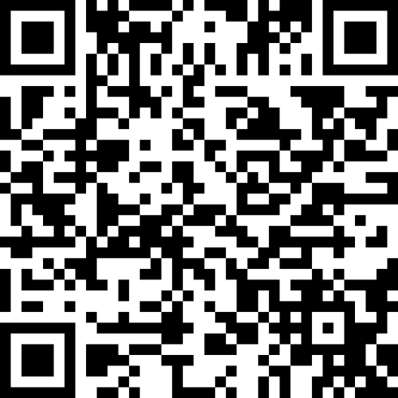
58%
30%
of academic and research staff are women
of female graduates of IUT
SUSTAINABILITY REPORT INDUSTRIAL UNIVERSITY OF TYUMEN 2023
18

Slide 19
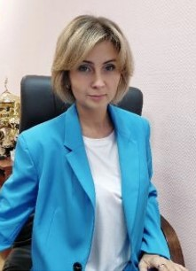

Professor of the Industrial University of Tyumen, Maria Zemenkova became a laureate of the Leader of the Year in Scientific and Innovative Activity-2022 Competition in the nomination of Scientist of the Year in the field of Engineering Sciences. According to the competition regulations, the significance of the contribution of scientists to the development of innovation processes was determined taking into account the scientific and technical level of the developed samples and technologies, their competitiveness, as well as the scale of their implementation. The publication activity of scientists was also assessed.
Industrial University of Tyumen acted as a partner of the discussion session of the TNF industrial and energy forum, which was attended by activists of the regional branch of the Union of Women of Russia. The main issue for discussion was the role of women in high-tech production and technological entrepreneurship.
The speakers were top managers of leading oil and IT companies who shared their unique experience and inspiring success stories. The session also featured the Names of Beautiful Women Exhibition, organized by the Museum of the History of Science and Technology of the Trans-Urals named after D.I. Mendeleyev of the Industrial University of Tyumen. The exhibition is dedicated to women, who are geologists, builders, scientists and the first teachers of IUT; along with men, they accepted all the hardships of taiga life and stood at the origins of oil and gas production.
Candidate of Technical Sciences, Larisa Epifantseva became a laureate of the Engineer of the Year-2022 of the All-Russian competition in the nomination of Organization of Management of Scientific and Engineering Activities according to the Professional Engineers version.
Experts distinguished the high professionalism of Larisa Epifantseva, her ability to find successful solutions to problems in teaching, scientific and engineering activities. Associate Professor of the Department of Building Structures of IUT is one of the developers of scientific and design documentation for the restoration and preservation of a number of cultural heritage sites in the Tyumen region. She developed an engineering calculation method and proved the economic efficiency of using strip-shell-type foundations in low-rise construction in engineering practice. The research results were implemented in the construction of three-story residential buildings in Novy Urengoy and Tyumen. Larisa Rafailovna teaches university students a series of disciplines dedicated to the operation and repair and restoration of buildings and structures, information modeling in construction. She is the author of 3 learning guides and 1 textbook, as well as more than 60 published scientific papers and invention patents. After winning the competition, her name was registered in the list of professional engineers of Russia.
SUSTAINABILITY REPORT INDUSTRIAL UNIVERSITY OF TYUMEN 2023
19

Slide 20

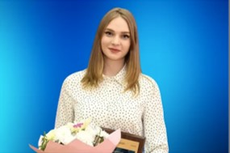
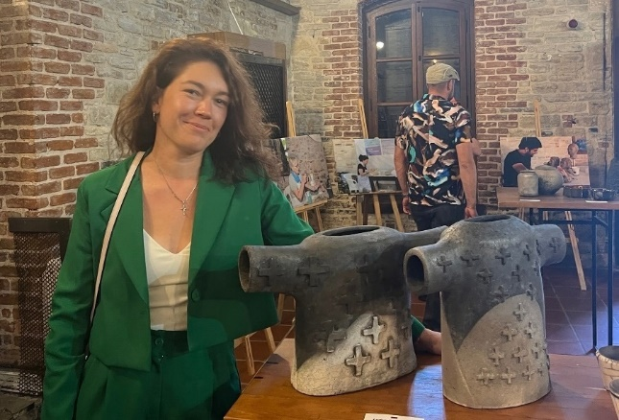
In the Akademina 2023 Competition among women scientists, the grand prix in the Scientific Debut Nomination was received by a student of the Industrial University of Tyumen, Maria Babaeva. Ms Babaeva received the high award for her achievements in scientific and research activities. Maria is a prospective petroleum engineer, studying in the field of Petroleum Engineering at the Nizhnevartovsk branch of IUT. She is engaged in research dedicated to the development of innovative equipment for drilling and operating wells. The young scientist has written 17 publications. Maria is also a prize-winner of various conferences and competitions for young scientists, and actively participates in public activities.
Associate Professor of the Industrial University of Tyumen, Head of the Basic Department of AO Mostrostroy-11, Natalia Breus was awarded the honorary title of Honored Economist of the Russian Federation. The order, signed by Russian President Vladimir Putin, was published on the official website of legal information. The award was presented for merits in the field of economics and finance, as well as many years of dedicated work. Natalia Leonidovna is an active participant in the specialized committees of the National Association of Infrastructure Companies on pricing, treasury and banking support, an active participant in the working groups on pricing and digitalization under the Ministry of Construction of the Russian Federation and the Federal Road Agency. The area of professional and scientific interests of Natalia Leonidovna is the study of the problems of construction companies and the formation of innovative approaches to their solution, the development of tools to improve the productivity and efficiency of contracting organizations based on changing approaches to the formation of the contract price, digitalization of construction processes.
Associate Professor of the Department of Architectural Environment Design at the Industrial University of Tyumen, Lyudmila Kozlova, presented her works at the International Symposium on Ceramics in Turkey. The event was attended by 27 ceramic artists from 12 different countries. Lyudmila Vladimirovna introduced the audience to her work, presenting the panel "Water", and also spoke about the traditions of our country and region. Moreover, inspired by communication with colleagues and the atmosphere of the sunny republic, the artist created a sculpture and entitled it as Epiphany Day.
SUSTAINABILITY REPORT INDUSTRIAL UNIVERSITY OF TYUMEN 2023
20

Slide 21
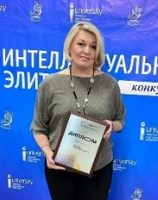
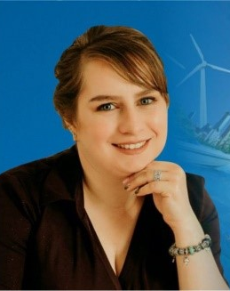
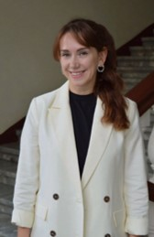
Women in Science Review:2023
Aksenova Natalia Aleksandrovna, Candidate of Technical Sciences, Associate Professor, Director of the Technology Transfer Center. Author of more than 170 scientific publications, including 30 articles of the Higher Attestation Commission, 7 articles of Scopus, 5 monographs, 8 inventions, 14 textbooks.
Guryeva Maria Andreevna, Associate Professor of the Department of Economics and Organization of Production of the Institute of Service and Industry Management of IUT, Candidate of Economic Sciences, Professor of the Russian Academy of Natural Sciences. Author of more than 200 scientific articles, 6 monographs, 6 patents.
Bogdanova Olga Viktorovna, Professor of the Department of geodesy and cadastral activities of the Institute of Service and Industry Management, Doctor of Economic Sciences, Associate Professor, author of more than 70 publications, 5 monographs, 7 textbooks and other works.
Research area is innovations in the management of regional and industry systems (rational nature management and territory management, management of specially protected natural areas, project urbanism and city analytics).
SUSTAINABILITY REPORT INDUSTRIAL UNIVERSITY OF TYUMEN 2023
21

Slide 22
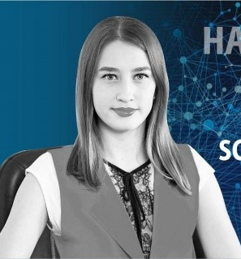
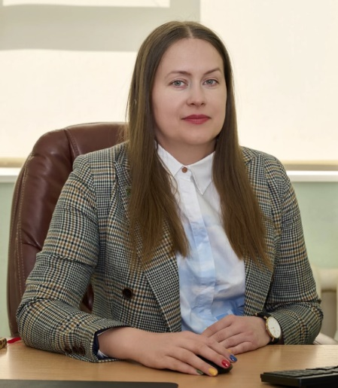
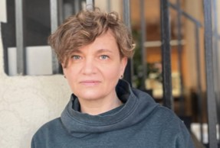
Women in Science Review:2023
Kolyadko Alesya Anatolyevna, Associate Professor of the Department of Petroleum Engineering of the University branch in Surgut, Candidate of Technical Sciences. Author of 34 articles in publications included in the international citation databases, Web of Science and Scopus, more than a dozen articles in journals from the list of the Higher Attestation Commission (HAC), more than 50 articles in publications included in the Russian Science Citation Index (RSCI), co-author of 1 monograph.
Kurushina Viktoria Aleksandrovna is the Head of the laboratory of vibration and hydrodynamic modeling; she holds a PhD in Engineering from the University of Aberdeen in the UK. She is the author of 42 scientific publications.
Korsun Natalia Dmitrievna, Associate Professor of the Department of Building Structures of the Construction Institute of IUT, PhD in Engineering, Associate Professor, author of 46 publications, two textbooks and three learning guides on the design of metal structures. Supervisor of more than 20 student research projects, several of which were awarded prizes at regional and international competitions.
For the high level of professionalism and training of personnel for the construction complex, she was awarded certificates of honor from the Department of Education and Science of the Tyumen Region, the Union of Builders of the Tyumen Region, letters of thanks from Innopolis University, Tomsk State University of Architecture and Civil Engineering, Tyumen State University and Industrial University of Tyumen. She is a laureate of the Engineer of the Year All-Russian Competition.
The scope of scientific interests includes lightweight and thin-walled steel structures of buildings and structures. They are used in low-rise civil engineering, in the construction of industrial buildings such as storage sheds, in the reconstruction or extension of houses, for the construction of temporary structures, for example, in glampings.
SUSTAINABILITY REPORT INDUSTRIAL UNIVERSITY OF TYUMEN 2023
22

Slide 23
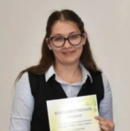
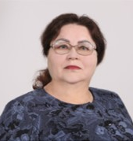
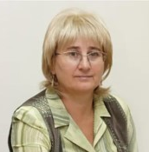
Women in Science Review:2023
Litvinova Natalia Anatolyevna, Doctor of Technical Sciences, Associate Professor, Professor of the Department of Technosphere Safety, Member of the Russian Academy of Natural Sciences (RANS), Professor of RANS, Professional Engineer of Russia. Has more than 180 publications in Russian and foreign scientific journals, 2 patents for invention, 2 certificates for programs for electronic computers (ECM). Research area is environmental protection, industrial safety and health-saving technologies. Scientific topic registered from 2018 to 2022, as follows "Development of methods for optimizing the ventilation system and improving the quality of indoor air from energy and transport facilities."
Smirnova Olga Yuryevna, Candidate of Technical Sciences, Associate Professor of the Department of Intelligent Systems and Technologies, Certified Consultant on the Safety of Transportation of Dangerous Goods of the Federal Service for Supervision of Transport of the Russian Federation, Expert-Master of the WorldSkills global movement in the Freight Forwarding Competency. Author of more than 85 works, including 1 monograph, 1 patent, 4 textbooks, 1 article in publications indexed in Scopus citation databases.
Research area is transport systems and technologies, design and operation of transport and technological machines. Scientific topic registered from 2021 to 2024, as follows "Improving the efficiency and quality of road transport".
Pimneva Lyudmila Anatolyevna, Doctor of Chemical Sciences, Professor, Full Member of the Russian Academy of Natural Sciences. Author of 223 scientific publications, 3 patents. Research area is environmental protection, industrial safety and health-saving technologies.
SUSTAINABILITY REPORT INDUSTRIAL UNIVERSITY OF TYUMEN 2023
23

Slide 24
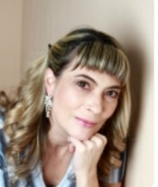
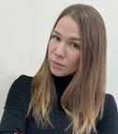
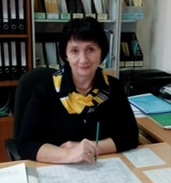
Women in Science Review:2023
Syzrantseva Ksenia Vladimirovna, Associate Professor, Doctor of Technical Sciences, Professor of the Russian Academy of Natural Sciences. Has a Certificate of Honor of OAO TNK-Nyagan. Author of about 180 scientific papers, including 155 articles, reports (Czech Republic, Slovakia, Bulgaria, Poland, China, England, Germany, France, Serbia, USA), 2 certificates of state registration of computer programs, 5 monographs. Ksenia Vladimirovna is the executor of four research papers and two grants.
Research areas are as follows mechanical and physical-technical processing of materials, oil and gas equipment technologies; industrial safety; design and operation of transport and technological machines.
Gaiduk Maria Yuryevna, PhD in Architecture, Deputy Director for Science and Innovation at the Institute of Architecture and Design of Industrial University of Tyumen, Associate Professor of the Department of Architectural Environment Design, member of the Union of Architects of the Russian Federation.
The main results of her scientific research have been published in 21 scientific articles, including 12 in periodicals recommended by the Higher Attestation Commission of the Russian Federation and 3 in editions indexed in Web of Science and Scopus.
Her area of ​​interest is the architectural heritage of our region: reconstruction, restoration, adaptation of objects, inclusion of cultural heritage objects in the modern life of the city. The issues of interaction between historical and modern development are of great interest.
Udartseva Olga Vladimirovna, Doctor of Technical Sciences, Associate Professor, Professor of the Department of Technosphere Safety. Author of 70 publications in Russian and foreign scientific journals, 2 patents, 5 certificates of registration of computer programs. Research focus is environmental protection, industrial safety and health-saving technologies.
SUSTAINABILITY REPORT INDUSTRIAL UNIVERSITY OF TYUMEN 2023
24

Slide 25

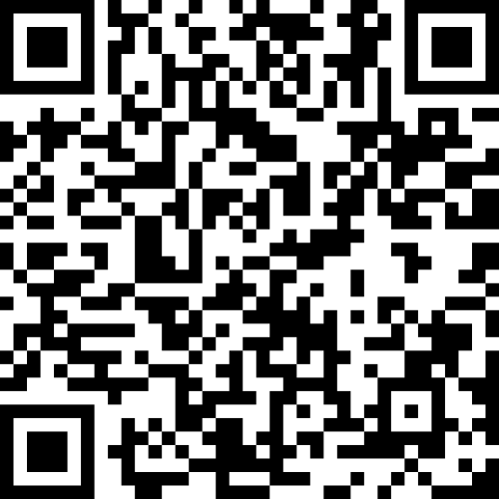
3
8
programs of higher professional education
publications
SUSTAINABILITY REPORT INDUSTRIAL UNIVERSITY OF TYUMEN 2023
25

Slide 26
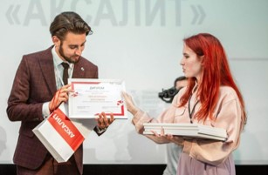
Industrial University of Tyumen took the second place in the rating of "green" universities of Russia by the interregional environmental public organization ECA, aimed at forming an environmental culture in the community of higher education organizations. The rating methodology was developed within the Green Universities of Russia All-Russian Program Framework.
When determining the final assessment of the educational institution, the degree of environmental friendliness was taken into account in the following areas: educational programs and research activities in the field of ecology and sustainable development, environmental education and formation of environmental ethics at the university, responsible waste management practices, water and energy conservation, reducing the transport footprint of the university, environmentally responsible purchases of the university, activities to preserve and restore forests.
Within the framework of the rating, the top five leaders in individual areas were also determined; IUT became the first in the "Water" section.
The Industrial University of Tyumen hosted the annual national scientific and practical conference with international participation "Water Resources — the Basis of Global and Regional Development Projects for Russia, Siberia and the Arctic in the 21st Century". The purpose of the conference was to discuss issues of socio-economic development of regions, cities and rural settlements of Russia, as well as to increase the efficiency of using the natural, resource, labor and scientific potential of the territories of the Tyumen Region, Siberia and the Arctic. The conference was attended by representatives of regional authorities, enterprises and businesses, scientists, experts, students and postgraduates. The event was opened on World Water Day. The forum discussed issues of water resource conservation, urbanization, water treatment technology, wastewater treatment and many other topical issues of ecology and development of the territories of Siberia and the Arctic.
The list of key issues of the conference included the following topics:
Russia, Siberia, the Arctic in the face of global water challenges in the 21st century, as follows: water and peace; fresh water shortage and water conservation; water for human life and health; water and ecology; water and housing and communal services; water and agriculture; water and industry; water and energy.
Current issues of transboundary cooperation and basin management, strengthening scientific cooperation in water resources and sustainable development of the Urals, Siberia and Central Asian countries in the 21st century.
Progressive loss of forests, natural landscapes in river valleys and reservoirs. Issues of introducing nature-like, environmentally friendly technologies, systems for cleaning natural and waste water, land and air.
Scientists from the Industrial University of Tyumen are developing a unique technology for processing man-made waste from groundwater extraction, which can turn it into valuable raw materials for the production of new goods (S.M.Art Metals project). This approach is very important in view of the tendency towards river depletion, pollution and shallowing. It is noteworthy that for city residents, such a development will in the future reduce the dynamics of price growth for water extracted from underground sources through wells. In 2023, the project received the AKSALIT award (formerly Metallurgist of the Year) in the Metallography nomination.
SUSTAINABILITY REPORT INDUSTRIAL UNIVERSITY OF TYUMEN 2023
26

Slide 27


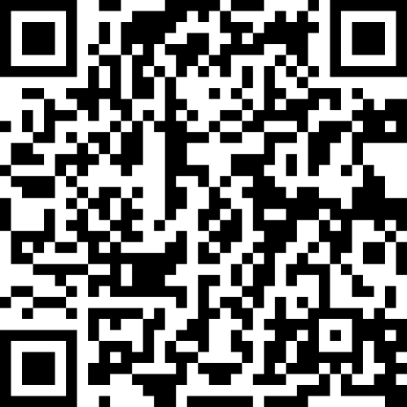
5
2
17
programs of higher professional education
programs of additional professional education
publications
SUSTAINABILITY REPORT INDUSTRIAL UNIVERSITY OF TYUMEN 2023
27

Slide 28
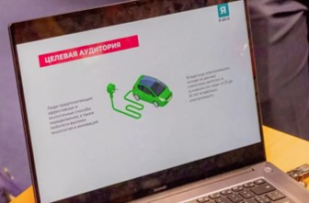
IUT students have developed a business project for charging stations for electric vehicles. The stations' capacity reaches 150 kW, which significantly reduces charging time. The advantages of the new complexes also include a loyalty system and the availability of filling stations with different capacities and connectors. Students pay great attention to installing stations on federal highways, where there are practically none. For the comfort of drivers, the area will be improved; in addition to filling stations, there will be shops and recreation areas.
Industrial University of Tyumen became a platform for the Power Engineer of the Future-2030 2.0 Foresight Session. Representatives of the industry and specialized partner universities of PAO Gazprom Neft discussed issues of training specialists for electric and thermal power engineering. The organizers defined four vectors of work for the participants to solve key problems related to the development of innovative creativity of young people in the energy sector, the formation of a system of joint project teams for the implementation of relevant products for business, the creation of a personnel reserve of students and graduates of partner universities, and the development of additional professional education. As a result, four teams, which included representatives of production, teachers and students, developed and presented their projects and proposals to the experts.
SUSTAINABILITY REPORT INDUSTRIAL UNIVERSITY OF TYUMEN 2023
28

Slide 29


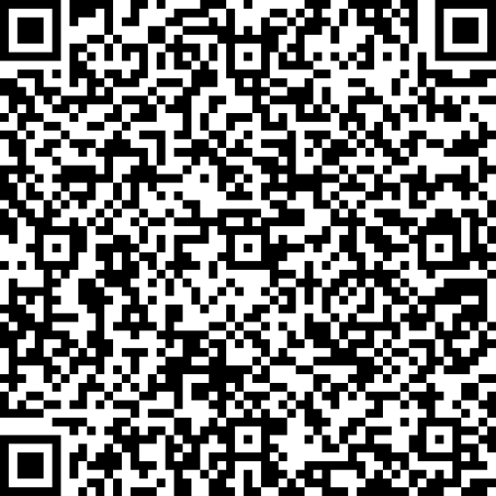
13
3
85%
programs of higher professional education
programs of additional professional education
ratio of employed graduates of IUT
3
7
programs of secondary vocational education
publications
SUSTAINABILITY REPORT INDUSTRIAL UNIVERSITY OF TYUMEN 2023
29

Slide 30
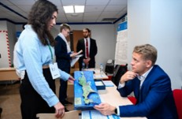
Industrial University of Tyumen for the second time has become a prize winner of the All-Russian competition for the best collective agreement held by the Ministry of Science and Higher Education of the Russian Federation and the All-Russian Trade Union of Education. The competition is aimed at improving the level of social security and quality of life of university employees. The university received a prize in the Best Collective Agreement on Regulation in the Social Sphere and Provision of Social Guarantees to Employees Nomination.
The competitive selection was carried out according to indicators characterizing the effectiveness of the content of the collective agreement as a legal act. Experts assessed the effectiveness of resolving issues related to the sphere of labor and social relations of the parties, the provision by the employer of conditions and guarantees for the activities of the trade union committee as a representative body of employees, as well as the relationship of the parties - social partners in the processes of concluding and implementing the agreement.
For many years, the university has had an effective Collective Agreement, based on which the university, among other things, organizes systematic work on additional professional education of employees in accordance with the legislation of the Russian Federation.
IUT won bronze at the federal stage of the Russian Organization of High Social Efficiency of All-Russian Competition in the For the Development of Social Partnership in Non-Manufacturing Organizations Nomination. 1027 enterprises from all over the country competed for the victory. The commission highly appreciated the social policy of the university, the systematic approach to regulating labor relations, as well as the provision of additional benefits and guarantees. According to the current Collective Agreement, each employee of IUT can choose a social package, which includes additional leave, spa treatment, travel expenses to a holiday destination, and others. Employees can also attend the university's sports leagues for free; receive partial compensation for a membership of swimming pools and fitness clubs.
The IUT Career Center helps graduates find job with good prospects, acts as a navigator for students - introduces them to industry leaders, helps find internships and work, holds career guidance events, master classes, meetings with representatives of prominent companies, helps in preparing CV and passing interviews. The center cooperates with more than 150 industrial partners of the university and has a rich database of vacancies, access to which makes it easier for university students to overcome the initial stage of their career and avoid mistakes.
IUT participation in the project to develop the digital career environment of Fakultetus opens up wider employment opportunities. Currently, 445 organizations and more than 8 thousand students and graduates are registered in the university profile on the Fakultetus Platform.
Since 2002, IUT has had a Headquarters of Student Teams. Among the universities of the Tyumen Region, IUT Headquarters is the largest, with more than 150 students becoming its members every year. Every year, teams are formed to undergo paid industrial practice. The university has especially well-represented construction teams that are engaged in the construction of various facilities (including those of nationwide) and specialized teams that provide service support for events at the university, city, regional and national levels.
SUSTAINABILITY REPORT INDUSTRIAL UNIVERSITY OF TYUMEN 2023
30

Slide 31

A project-analytical session of representatives of career centers of the Ural Federal District was held at the Industrial University of Tyumen. During the training sessions, specialists developed new approaches to conducting career events and interacting with HR and graduates, career center development programs, and also exchanged experiences and shared successful practices in implementing new mechanisms. Based on the results of the project-analytical session, proposals were prepared for the development and modernization of career events, digitalization and optimization of work processes and interregional interaction of university career centers.
The Industrial University of Tyumen hosted the Schlumberger Technology Company Days. 260 students from engineering and natural sciences took part in meetings with employers as part of the three-day program. Prospective specialists were told about the conditions for internships and employment, and were presented with the company leadership program aimed at developing the professional qualities of a field engineer. Building a career in a world-famous company is available to students starting from their second year of study. IUT graduates of 2023 who passed the preliminary selection were able to apply for participation in the Schlumberger leadership program, and penultimate year students were invited to undergo an internship.
The Industrial University of Tyumen launched two large-scale career and educational projects, as follows: a job fair and the Trud Krut Forum. Students and graduates of the university, representatives of the country's largest employers and the Russian student brigade movement gathered on one platform. More than 100 industrial partners of IUT took part in the Career Fest event, including the largest companies in the oil and gas, energy, construction and motor transport sectors of the Russian economy. Meetings of employers with students from all departments of the university were held in the format of express interviews. Students were able to communicate with representatives of the company HR departments, fill out questionnaires and leave their CV.
10 student teams of the university were busy at important sites in the country in 2023. The geography of projects has significantly increased this year. The female student construction team "Vesta" took part in the All-Russian student construction project "Peaceful Atom - Trinity" of the Rosatom State Corporation in the city of Troitsk, Moscow Region. Two male teams "Universal" and "Sparta" worked at the All-Russian construction site "Sever" and the Chayandinskoye field of PAO Gazprom in the Republic of Sakha (Yakutia). The "Ktizis" team conquered its first virgin land. They worked at the Interregional Student Construction Site "Alabuga" in the Republic of Tatarstan. The Oil Workers' Squad named after Viktor Ivanovich Muravlenko spent a work semester at the facilities of OOO Gazprom Burenie in Novy Urengoy. In 2023, the only Student Conductor Squad of Transit Express resumed its work. Its members worked in passenger trains going to the cities of Nizhnevartovsk, Makhachkala, and Adler. The "Tor", "Mega" and "Master" Squads worked in their home region, doing finishing works in the university buildings. In total, 169 members were involved in the work semester, 99 of whom had previously received industrial worker jobs.
SUSTAINABILITY REPORT INDUSTRIAL UNIVERSITY OF TYUMEN 2023
31

Slide 32


SIBUR Company Day was held at Industrial University of Tyumen. Everyone had the opportunity to participate in a career master class and pass an interview. Students were able to talk to the CEO, learn about the benefits of working at the enterprise, employment prospects and career growth for young people.
The Industrial University of Tyumen held the grant competition "Teacher of the Year 2023". This year, the competition brought together 28 participants from all departments of the university: institutes, branches, college and lyceum. Masters of industrial training, teachers and assistants, associate professors and professors - all of them creatively approached the implementation of competition tasks. Experts evaluated video presentations, open classes and essays on the topic "My pedagogical philosophy". In addition, all participants completed training under the advanced training program at the Institute of Continuing and Distance Education.
The "Teacher of the Year" competition has been held at the Industrial University of Tyumen since 2010 with the aim of improving the quality of educational, methodological and educational work, developing the creative activities of teachers. The event is traditionally supported by the United Primary Trade Union Organization of the University.
Students of the Industrial University of Tyumen have developed 70 technology startups, participating in the acceleration program "Technohub". During two months of intensive training, young innovators worked on their business projects, improving their entrepreneurial skills under the guidance of experienced mentors.
Based on the results of the defense, 10 best startups were selected. In this case, experts not only evaluated the projects, but also gave practical advice on their further development.
Top 10 projects:
Device for applying ACP to a pipeline«.
Hydrogen generation in reservoir conditions«.
Development of an automatic control system for electric drives in the water supply sector based on digital twins«.
Automated monitoring of parking spaces«.
Lactoserum processing«.
Software for personnel navigation in an industrial area«.
Development of a desktop extruder for processing in additive technologies«.
Biogenerated gas«.
PUDA" (development of a hardware and software complex for apnea diagnostics).
Innovative soundproofing".
Since 2022, the University has been operating the Center for Technological Entrepreneurship (until September 2023 - the Youth Business Incubator). It was created to support the entrepreneurial and innovative activities of students and employees of the University. The Center has developed acceleration programs implemented under the Technohub brand.
The project was included in the list of the best advanced training programs based on the results of the selection of practices "Technologies of Personnel Sovereignty-2023", organized by the Agency for Strategic Initiatives, in the Engineering and Technological Entrepreneurship Nomination of the field of Engineering Training.
SUSTAINABILITY REPORT INDUSTRIAL UNIVERSITY OF TYUMEN 2023
32

Slide 33


10 projects by students of the Industrial University of Tyumen were included in the best business ideas of the All-Russian rating of the top 1000 university startups.
The highest position, the third line, was taken by the project "Educational Ecosystem on Electronics Samson". The project includes soldering kits for teaching the basics of electronics and a software package for designing electronic devices and printed circuit boards. The kits are already available for purchase on marketplaces and in stores in the city.
In 16th place is the project "SAMSON, Robot for Printing". The product is aimed at university students. This is a machine where you can print and stitch documents, diploma and coursework cheaper and faster than in a printing house. You can also use the machine to view the schedule and go to the IUT website.
The top 50 included a startup for the production of high-speed 3D printers InD3d. The improved device prints using the technology of layer-by-layer application of plastic and surpasses its competitors in speed several times. The following startups were also recognized as the best in the country:
Dating app "DATE" using artificial intelligence.
Kiddie educational mobile app on the basics of life safety "OBZheika«.
Development of a desktop screw extruder.
Biodegradable sensors for monitoring soil conditions.
Youth design studio.
Educational game business simulation on project management in a digital environment.
Smart padlock with remote control.
Since 2019, the university has been implementing the Honors Track, which is aimed at training innovative engineers and involves systematic work of students based on the results of a competitive selection on real projects aimed at developing the oil and gas industry.
The Honors Track project was among the best advanced training programs based on the results of the selection of practices "Technologies of Personnel Sovereignty-2023", organized by the Agency for Strategic Initiatives, in the Career Providers in APE Nomination in the field of Additional Professional Education.
The Industrial University of Tyumen held 4 training sessions organized within the framework of the Platform of University Technological Entrepreneurship Federal Project. More than 500 students of the Industrial University of Tyumen took part in the training of entrepreneurial competencies. For one day, they tried on the role of technological entrepreneurs.
According to the scenario of the game, the participants had to make a product from scrap materials: cardboard, threads, ping-pong balls, balloons, etc., then develop an economic strategy for its development, find investors, calculate all the risks and conclude a profitable deal by selling their business. The best students were invited to the Technohub University Acceleration Program for their business projects.
SUSTAINABILITY REPORT INDUSTRIAL UNIVERSITY OF TYUMEN 2023
33

Slide 34

47
7
48
programs of higher professional education
programs of additional professional education
publications
9
1
programs of secondary vocational education
massive open online course
SUSTAINABILITY REPORT INDUSTRIAL UNIVERSITY OF TYUMEN 2023
34

Slide 35


The Industrial University of Tyumen has a Center for Advanced Research and Innovative Developments. The Center has 26 laboratories and more than 300 units of equipment. The total area of the Center is 2,400 sq. m. The laboratory complex is designed to train students, fulfill orders from industrial partners, conduct research and testing.
The Centre’s areas of work include: oil and gas processing, oil and gas industry, food technology, biomedical systems and technologies.
One of the most high-tech laboratories is designed to study drilling and cementing fluids. A rare device is installed here - a high-temperature electronic viscometer. With the help of such equipment, it is possible to test drilling fluids during the extraction of hard-to-recover oil reserves and optimize drilling operations. There are only five such devices in Russia.
In the laboratory for designing functional food products, scientists and students create vitamin and mineral complexes that enrich food products, giving them health-preserving properties. Food additives do not contain artificial components. Only natural plants from Siberia and the Arctic are used for their development.
There is a specialized testing laboratory to determine the quality of products and water. Modern equipment allows taking samples to determine the safety indicators of drinking water, wastewater, soil, food products, construction and finishing materials, containers and packaging.
The Centre is working on 24 socially significant projects. Scientists are creating high-strength construction materials, designing electric vehicles for people with disabilities, and developing new software applications.
Students of the Industrial University of Tyumen have developed a project for a personnel movement monitoring system – special bracelets equipped with a tracker and a tracking system that shows the movement of workers in a 3D model, an alarm button in case of emergencies, a health monitoring sensor and fingerprint identification. They successfully presented their startup idea at the Technohub acceleration program. The team has already developed a design and a 3D model of the bracelet, and a potential customer has been found at whose enterprise the bracelets will be tested.
Associate Professor of the Institute of Transport of the Industrial University of Tyumen is conducting a study of traffic flows based on neural networks. The young scientist won a grant from the Presidential Program of Research Projects of the Russian Science Foundation to implement his idea. The main objective of the study is to prevent traffic jams in cities. To do this, the scientist proposes to process video information from traffic cameras using neural network technologies, which will allow obtaining up-to-date statistical data and establishing new patterns with a large number of various factors and options for organizing traffic. This will help to form algorithms for managing traffic flows and develop practical recommendations. As a result, motorists will lose less time when moving around the city, fuel consumption will decrease, and emissions of harmful substances into the atmosphere will decrease. All together, this will help reduce the social discomfort that currently arises due to traffic jams, and increase the status and attractiveness of the city.
SUSTAINABILITY REPORT INDUSTRIAL UNIVERSITY OF TYUMEN 2023
35

Slide 36


First-year students of the Industrial University of Tyumen have proposed an improved technology for contactless payment by bank card. Instead of mobile applications, a modernized UniKey 2.0 phone case is used, in which a special device with a bank card is built in. Thus, users will be able to pay for purchases with a card of any payment system, including Visa and Mastercard, without taking it out.
The device has additional functions: protection against illegal write-off of funds, a key-pass to work or a key to the intercom, keyless access to the car, the ability to store all passwords and transfer them via NFC technology. The most important thing is that UniKey 2.0 does not have a battery, so it does not need to be charged.
The guys presented their development at the Technohub acceleration program. Having received feedback from experts, the students decided to improve the project. The students have already developed a circuit board, the internal logic of the device and created three different prototypes. They are participating in various grant competitions; after receiving financial support they will begin to implement the project.
Participants of the Technohub acceleration program, 3rd-year students of the Institute of Industrial Technologies and Engineering, Mechatronics and Robotics department, proposed to improve the computer mouse by adding mechanisms of tactile feedback and changing the geometry of the case. According to the authors, a special unit will create resistance to an attempt to move the mouse. For example, users will be able to feel the weight of computer files or try the mode of bringing the mouse cursor to active interface elements. Changing the shape of the case will allow you to feel the depth of the image on the monitor, and directional vibration through mechanical vibrations will notify you of the mouse pointer hovering over the target. Thus, by hovering the cursor over a geographic map, you can feel the height of the mountains and other irregularities. The mouse will also be equipped with an optical sensor and a microcontroller.
The team has already created a demo prototype and a software version for the "advanced" mouse. A resistance module and drivers for the Windows operating system are in development. Thanks to the new features, the mouse will no longer be just an input device, but will be able to improve human-computer interaction.
A specialist from the Department of Construction Materials at Industrial University of Tyumen has created a way to increase the service life of asphalt concrete by 20% using a complex-action stabilizing additive for stone mastic asphalt concrete (SMA), which is used in the upper layers of road surfaces.
According to the author, a rational combination of additive components increases the strength of asphalt concrete, reduces its sensitivity to temperature effects, preventing the formation of microcracks and increasing resistance to aging. The development has already been patented and is used almost throughout Russia. In Tyumen, the developed additive is used by such companies as Pyshmaavtodor, M-Stroyindustriya, and Spetsstroytekhnika.
SUSTAINABILITY REPORT INDUSTRIAL UNIVERSITY OF TYUMEN 2023
36

Slide 37


Students of the Institute of Industrial Technology and Engineering are developing a device capable of creating a metal coating on any surface. The new device will not only protect the material from negative external influences and destruction, but also increase its hardness and wear resistance.
It is planned to use metal wire as a consumable material - this is one of the main advantages of the development along with its low cost. The device also has a compact and lightweight design, does not affect the environment, and is easy to use. The new device will find application in any field from industrial to decorative. It can also be used in the oil and gas industry, for example, to combat corrosion and increase the strength of pipelines. And thanks to the extremely clear configuration for any user, the device will be useful even at home in interior decoration.
A student of the Industrial University of Tyumen proposed launching an industrial technology park in the Tyumen region with modern sites for the production of unique children's construction sets, engineering, science and education.
The use of an innovative method – 3D printing technology on a 3D printer in the production of toy construction sets – will improve the quality and uniqueness of the manufactured products.
The girl's idea was highly appreciated at the International Competition of Scientific Works of Youth in Economics. The competitors were 273 participants from 61 subjects of the Russian Federation. Following the results of the in-person defence, the Tyumen resident was among the winners, taking third place.
Students from the Industrial University of Tyumen are working on developing 3D printers that surpass existing models in a number of parameters – I&D printing tech, implemented within the framework of the Technohub acceleration program. The startup is an open-source project, i.e. it has open-source software and is easily customized to the customer's needs. The students have already created a prototype of the mini version, a beta version of the middle printer and a model of the max version, as well as calculated the business model and developed a corporate website.
The project authors' immediate plans include establishing a full-fledged start of sales of the mini version and completing the middle and max versions, as well as developing a brand of domestic accessories InD and entering marketplaces.
The new automated system Home++, developed by students of the Industrial University of Tyumen, Moscow Polytechnic University and MIREA - Russian Technological University, is capable of protecting the house from fire, leaks and monitoring air quality. The invention is easily adapted for use not only in residential premises, but also in industrial enterprises, and the number of "smart" sensors is unlimited.
The team has already received the first grant for the implementation of the project, and also took part in the Technohub acceleration program.
Another advantage of the student development is the price. According to the authors, the cost of the product will be reduced by creating its own data transfer protocol, therefore, large expenses on this item are not envisaged.
The model of the device is already ready, and it can be controlled from a smartphone. Now the students are working on creating a common control module that will unite all the sensors.
SUSTAINABILITY REPORT INDUSTRIAL UNIVERSITY OF TYUMEN 2023
37

Slide 38

Scientists from the Industrial University of Tyumen have become winners of the regional stage of the 2023 All-Russian Society of Inventors and Innovators (RSII) Award.
The winners included:
Natalia Litvinova, professor of the Russian Academy of Natural Sciences, associate professor of the Department of Technosphere Safety at Tyumen University. Her invention is a forced ventilation valve, designed to supply air in multi-story buildings and to effectively clean it.
Evgeny Kozin, associate professor of the Department of Automobile Service and Technological Machines. The invention is a digital twin of a motor transport enterprise, which allows modelling its operation based on mathematical methods and artificial intelligence technologies.
Lev Maksimov, engineer at the Centre for Advanced Research and Innovative Development. The invention is nano- and micro-dispersed iron-containing powders used to purify wastewater, increase oil production, and perform flaw detection in aviation.
Students from the Industrial University of Tyumen are working on creating a device for round-the-clock monitoring of forest fires – a hardware and software complex developed on the basis of neural networks.
The principle of operation of the device: the device is installed on a hill, records a fire and transmits information to the Ministry of Emergency Situations. It is planned to equip the device with an infrared beam, which, reflected in the rotating mirrors, will be able to penetrate an area with a range of more than 100 km and detect a fire. Thanks to it, it is possible to extinguish not only forest fires, but also peat fires in time.
The guys presented their development at the final defence of the Technohub 2.0acceleration program and received funding for the development of the project from the IUT Startup Studio.
Students from the Industrial University of Tyumen have become winners of the Start-Vzlet program of the Innovation Promotion Foundation and have won a grant to develop a quadcopter with a power plant on one internal combustion engine (ICE). The goal of the aspiring innovators is to increase the flight time and load capacity of an unmanned aerial vehicle (UAV), as well as to adapt the device for use in low-temperature conditions where conventional drones do not work.
One of the main features of the proposed ICE copter is the coaxial arrangement of the propellers. Thanks to it, the dimensions and weight of the body are reduced. It is planned to use liquefied natural gas as fuel, which is more environmentally friendly. The copter can be equipped with a spraying system, which will allow it to be used for field processing. In addition, it can also be used for cargo delivery, monitoring, aerial photography, exploration of deposits, searching for gas leaks and other tasks.
At the IUT School of Engineering Reserve a Youth Design Studio (YDS) was established, bringing together university and high school students to create innovative startups and implement technology projects.
The founder of the YDS, a student of the Construction Institute, presented his project at the educational intensive course Archipelago-2023. Based on the results, a decision was made to include the IUT Studio in the future All-Russian network of youth design bureaus, which is being created by the Ministry of Science and Higher Education of the Russian Federation and the Higher School of Economics, a National Research University.
The main areas of the Studio's projects:
Electronics and robotics
Composite materials
Oil industry
Construction
Materials science.
SUSTAINABILITY REPORT INDUSTRIAL UNIVERSITY OF TYUMEN 2023
38

Slide 39

A student at the Industrial University of Tyumen is working on creating robotic equipment based on artificial intelligence to monitor the condition of offshore pipelines. The project was presented at the Ticket to the Arctic competition and was among the 30 finalists.
The young researcher's development is designed to solve the main problem in oil and gas production - detection of weld defects and their elimination in main pipelines, including in Arctic fields. To do this, the student proposes to create a robot capable of monitoring equipment and, if necessary, repairing it. At the same time, human participation is reduced to a minimum. According to the author's idea, the robot will be equipped with the necessary equipment: video cameras, thermal sensors, ultrasonic scanners, which will be able to provide information on the condition of the pipeline and welds. Using artificial intelligence algorithms, the robot is able to recognize defects, such as cracks or corrosion on welds, and decide on the need for repairs.
Students of the Mechatronics and Robotics program at the Institute of Industrial Technology and Engineering at IUT are creating robots for laboratory research of core samples – a substance taken during well drilling – a universal robot manipulator and a robot for inventorying core storage facilities.
The principle of the universal robot manipulator is simple: the robot, according to the program, grabs the sample and moves it to the stand. After that, it turns the gripper so that the camera installed on it is oriented to the sample. Then the sample is photographed with automatic transfer of information to the database. At the same time, due to the fact that the camera is not installed stationary, but on the robot, you can choose any angle when photographing.
The use of a robot for core storage inventory will allow for the full automation of the inventory process, including for independent audit, which is often a labour-intensive procedure carried out manually.
The guys presented working models of their developments at the annual technology forum of the Tyumen Oil Research Centre of the Rosneft Oil Company.
A student at the Industrial University of Tyumen is developing a new format for psychological testing. The author's main idea is to use computer games in the visual novel genre instead of standard tests. The student won a grant in the Student Startup competition to implement the project.
The web resource can become an excellent alternative to standard psychological testing methods. The respondent will be asked to play a game in which his character finds himself in various situations that require decision-making. Testing will be able to determine a person's emotional state, identify strengths and weaknesses of character. At the same time, users can choose the area they are interested in. The author of the project is confident that this approach will help choose a candidate for the position, based on reliable information about a person's emotional state and motivations.
A young lecturer from the Industrial University of Tyumen has proposed his solution to one of the most pressing problems in oil and gas production – increased water cut in wells – by developing a new complex technology for limiting water inflows using sediment-forming compounds and cement resin.
Despite the fact that flooding of wells during the development of hydrocarbon resources is a natural process, it is a fairly large problem that affects about 80% of the fields in Western Siberia.
The developer presented a new technology that will help increase hydrocarbon production at TNF-2023 and became the winner of the Technohub 2.0acceleration program.
SUSTAINABILITY REPORT INDUSTRIAL UNIVERSITY OF TYUMEN 2023
39

Slide 40


1
3
3
program of higher professional education
massive open online courses
publications
SUSTAINABILITY REPORT INDUSTRIAL UNIVERSITY OF TYUMEN 2023
40

Slide 41


The Industrial University of Tyumen has become a prize winner of the All-Russian competition for the best collective agreement, held by the Ministry of Science and Higher Education of the Russian Federation and the All-Russian Trade Union of Education, for the second time. The competition is aimed at increasing the level of social protection and quality of life of university employees.
The current collective agreement of IUT for 2021-2024 provides for the choice of university employees of one of four options for a social program, within the framework of which they can receive various opportunities: compensation of part of the costs of spa treatment, educational services, travel to the vacation spot, payments for visiting sports clubs, swimming pools and much more. Participation in the collective agreement gives employees the right to mortgage lending, provision of housing for temporary use, payments related to memorable dates and events, assistance to single and large families.
IUT has a super service called Online University Admission. Applicants can remotely submit documents for budget, employer-sponsored, preferential and contractual places in bachelor’s and specialist’s degree programs for all forms of study. The super service is available on the State Services portal. Here you can select the desired university and area of study, send an application to the admissions committee, sign up for entrance examinations, track the status of document processing and exam results, and receive information about enrollment. Also, for the convenience of future students, the Telegram channel IUT Applicant has been created, where up-to-date information on specialties, passing scores, and the number of places for admission on a budget and contract basis is published.
45 schoolchildren aged 14 to 16 from the Donetsk People's Republic visited the Industrial University of Tyumen as part of the federal project University Shifts.
The initiators of the project are the Ministry of Science and Higher Education of the Russian Federation, the Ministry of Education of the Russian Federation and Movement of the First, the Russian children and youth movement.
The Industrial Holidays shift, organized by IUT, lasted 12 days. Participants were offered three tracks aimed at developing their soft and hard skills.
The career guidance track allowed them to get acquainted with the history and achievements of the university, professions and their requirements. The track Values and Areas of the Movement of the First is aimed at attracting active participation in social projects and strengthening the civic-patriotic position. The cultural and educational track contributed to uncovering the leadership, creative and sports potential of the participants.
There were also entertainment events, meetings with interesting people and educational master classes.
SUSTAINABILITY REPORT INDUSTRIAL UNIVERSITY OF TYUMEN 2023
41

Slide 42


The Industrial University of Tyumen team took second place in the competition for the best student dormitories in the Ural Federal District. In 2023, the university was represented by the Council of Dormitory No. 5. Ten teams from different cities of the Urals Federal District competed in the competition. Participants had to talk about the activities of the student council, hold a meeting, and demonstrate knowledge of housing laws in order to be able to help students.
The main task of the student council is to create a cozy atmosphere for everyone in the dormitory. 568 people from 34 regions of Russia live in the University's dormitory No. 5. The activists organize leisure activities and solve a variety of issues - they help first-year students with organizational issues and adaptation when settling in.
IUT has the largest dormitory fund in the region. The student campus of the university in the city of Tyumen includes 12 dormitories, where more than 4,000 students live.
The IUT Interclub took third place in the All-Russian competition of interethnic clubs Unity in Diversity - 2023 in the nomination Best practice in strengthening interethnic friendship and unity in the student environment. Created at the university more than ten years ago, the Interclub helps foreigners coming to Russia to quickly adapt and integrate into the university and cultural environment, to join the educational, scientific, creative and sports life of IUT. The association is aimed at developing international youth self-government, support and cooperation in solving the problems of students from different countries.
The Industrial University of Tyumen hosted a scientific and practical conference entitled Water Resources – the Basis of Global and Regional Development Projects for Russia, Siberia and the Arctic in the 21st Century.
Representatives of regional authorities, enterprises and businesses, scientists, experts, students and postgraduates took part in it. The forum discussed issues of water conservation, urbanization, water treatment technology, wastewater treatment and many other pressing issues of ecology and development of Siberia and the Arctic. The list of key issues of the conference included the following topics:
Programs and projects for the development of the West Siberian oil and gas complex in the 21st century and their impact on the habitat of indigenous peoples of the North, the creation of new jobs, the adaptation of newcomers, the safety and sustainable development of northern settlements.
Problems of managing demographic and migration processes in Russia and abroad, in the context of increasing social inequality in societies and the growing gap between rich and poor countries.
SUSTAINABILITY REPORT INDUSTRIAL UNIVERSITY OF TYUMEN 2023
42

Slide 43


34
3
19
programs of higher professional education
programs of additional professional education
publications
2
2
programs of secondary vocational education
massive open online courses
SUSTAINABILITY REPORT INDUSTRIAL UNIVERSITY OF TYUMEN 2023
43

Slide 44


Students of the Industrial University of Tyumen presented promising design projects for the creation of art objects in the city at the annual competition Time of the Future. Participants proposed installing unusual sculptures and benches, a wooden portal, a stele and a swing. All final projects were offered to the city administration for implementation while preserving the authorship.
The library and publishing complex of the Industrial University of Tyumen has published the first Russian textbook on the strategy of innovative development named Smart City. It is based on research conducted by the university's scientists as part of a strategic project to create a regional cluster in the sphere of smart competencies city, the Internet of Things and big data.
The topic of "smart" technologies is being actively developed at IUT, and the master's program Information Systems and Technologies (Smart City Intelligent Technologies) is being implemented. Together with scientists and experts, students make projects and solve cases for different spheres of life. Among their developments, for example, is a medical service for assessing the risk of cardiovascular diseases, a digital platform for managing a cottage village, a drone port, and others.
Sustainable urban development strategies provide for effective participation of citizens, so the manual pays special attention to issues of initiating effective interaction of residents with municipal authorities. In addition, each chapter highlights the main problems, the solutions to which can form the basis for developing creative projects for students.
The Conceptual Foundations of the Strategy of Innovative Development of the City within the Framework of the Smart City Regional Scenario textbook can be used not only in the training of students and postgraduates, but also in the advanced training and retraining of personnel, in the work of employees of state authorities and local governments.
Students of the Industrial University of Tyumen have developed a mobile application for preschool and primary school children. Its main objective is to teach children the basics of life safety, give practical advice and minimize the risks of childhood injuries. Thanks to the bright visuals, charismatic character and well-thought-out mechanics, the mobile application will captivate the child and will become an excellent assistant when acting in dangerous situations.
The developers presented their project for the first time at the Technohub acceleration program for the development of technological entrepreneurship. Experts highly appreciated the idea and recognized the development as the best in the flow. The Industrial University of Tyumen has summed up the results of the competition program of the educational project Safe Routes for Children and Teenagers. It was developed and is being implemented at the University's Centre for Architectural Training. The project is aimed at solving the problem of children and teenagers aged 12-18 years having no visual and practical experience of threats, understanding and awareness of the degree of their danger. Based on the results of the competition, methodological materials, safe route maps and safety island concepts were developed.
SUSTAINABILITY REPORT INDUSTRIAL UNIVERSITY OF TYUMEN 2023
44

Slide 45

Future architects have proposed interesting ideas for creating a student campus in Tyumen. Students worked on developing concepts within the framework of the Campus of the Future International Summer School together with experienced architects - teachers of the Industrial University of Tyumen. After five days of work, the participants, united in five teams, presented conceptual solutions for a specific territory taking into account social, economic, natural and engineering factors. The School participants named the main principles for forming the campus territory as the improvement of the urban area, the creation of an innovative environment, increasing the tourist attractiveness of the city, organizing youth leisure and developing a market of ideas for student startups.
The team of the Industrial University of Tyumen became the best in the project work competition State for People, held among the participants of the Youth Reserve of the Tyumen Region. The students won with the ProRegion Automated Forecasting System project.
The project is dedicated to the creation of an automated forecasting system that is capable of processing comments, appeals and remarks of citizens from various sources, categorizing them and automatically transmitting the processed data to the relevant government bodies. Representatives of the relevant government bodies and public institutions have already expressed interest in the idea, and it is planned that further work will be joint.
Students from IUT have developed a business model for increasing the number of fast charging stations in the Tyumen region to solve the problem of the duration of charging electric cars. According to the authors, by 2025 the number of electric charging stations will increase to 40. They will be located in residential areas of the city and on highways. And thanks to the capacity of the stations, the charging time will be reduced from three hours to 60 minutes. The students are paying great attention to installing stations on federal highways, where there are practically none. For the comfort of drivers, the area will be landscaped; in addition to filling stations, there will be shops and recreation areas.
Students and teachers of the Institute of Transport take direct part in the development of the transport infrastructure of the city of Tyumen, as well as in the strategic programs Smart City, Architectural Image of the Region, Medical City, Technopark and DSK-500.
Students of the Transport Process Technology program have completed over 50 projects. Future specialists modelled traffic flows taking into account dedicated lanes for passenger transport, assessed the effectiveness of changing the traffic organization scheme of central streets, as well as possible changes in traffic parameters when creating a continuous traffic arterial street – Melnikaite.
The Institute of Transport has the most modern software packages for modelling and transport planning. Students have at their disposal a unique laboratory where all research is conducted, the customers of which are, as a rule, the Main Construction Directorate of the Tyumen Region, the Department of Road Infrastructure and Transport of the Tyumen City Administration, Tyumengortrans.
A total of 300 people took part in the competition, with 30 of the most talented and creative young architects, designers and urbanists from all over the country reaching the final, including 9 IUT students. In the final round, the participants formed teams and worked on creating public space projects with the support of experts.
SUSTAINABILITY REPORT INDUSTRIAL UNIVERSITY OF TYUMEN 2023
45

Slide 46
In Tyumen, one of the historical streets, Lenina Street, is being reconstructed. The overhaul of the street is based on a project by architects from the Industrial University of Tyumen, which was approved by Tyumen residents in a popularity vote. In 2023, the first stage of the project was implemented - from the Historical Square to Krasina Street. The road surface and utilities were replaced, comfortable conditions for pedestrians were created, and a separate lane was allocated for scooters and bicycles.
Students of the Industrial University of Tyumen are developing an online platform ArtZone. It will allow residents and guests of Tyumen to track what events and performances of artists are taking place in the city. The project includes both a web version and a mobile application.
ArtZone mobile application includes:
announcement of events
selection by interests
Promotion
using an interactive map to select a route
notification of users
Students of the Institute of Architecture and Design became prize winners of the All-Russian urbanistic competition City Plan. Participants developed their own projects for the improvement of public spaces in Nyagan.
As part of the Russian Public Transport Week in Moscow, an agreement was signed between the Industrial University of Tyumen and the TransNet company, a domestic developer of software for transport modeling.
The partnership will be a new step towards technological sovereignty in the field of digitalization of urban development, construction, road and transport industries.
TransNet software is the first domestic product that allows designing the entire range of urban development transformations from the point of view of forecasts of the intensity of automobile and passenger flows in transport networks. The object of modelling can be the transport system of cities and road networks of any size. The product is a completely independent development of scientists from the Russian Academy of Sciences, which does not use third-party software products in its work.
A specialist from the Department of Construction Materials at the Industrial University of Tyumen has created a way to increase the service life of asphalt concrete by 20% using a complex-action stabilizing additive for stone mastic asphalt concrete (SMA), which is used in the upper layers of road surfaces.
According to the author, a rational combination of additive components increases the strength of asphalt concrete, reduces its sensitivity to temperature effects, preventing the formation of microcracks and increasing resistance to aging. The development has already been patented and is used almost throughout Russia. In Tyumen, the developed additive is used by such companies as Pyshmaavtodor, M-Stroyindustriya and Spetsstroytekhnika.
The Industrial University of Tyumen hosted a scientific and practical conference entitled Water Resources – the Basis of Global and Regional Development Projects for Russia, Siberia and the Arctic in the 21st Century.
Representatives of regional authorities, enterprises and businesses, scientists, experts, students and postgraduates took part in it. The forum discussed issues of water conservation, urbanization, water treatment technology, wastewater treatment and many other pressing issues of ecology and development of Siberia and the Arctic. The list of key issues of the conference included the following topics:
Current issues of architecture, service engineering, design, construction and operation of industrial facilities, housing and water supply and sanitation systems in Siberia and the Arctic, caused by global climate change.
Humanitarian projections of landscape-estate sustainable development of territories, services and quality of life in cities and settlements of Russia.
SUSTAINABILITY REPORT INDUSTRIAL UNIVERSITY OF TYUMEN 2023
46

Slide 47


48
10
28
programs of higher vocational education
programs of additional professional education
publications
9
2
programs of secondary vocational education
massive open online courses
SUSTAINABILITY REPORT INDUSTRIAL UNIVERSITY OF TYUMEN 2023
47

Slide 48


A team of young developers from the Industrial University of Tyumen has developed a project for the construction of a plant for the production of biodegradable products in the region.
The technology involves the production of biomaterials from two types of raw materials – wheat straw and industrial hemp. Wheat straw remains in the fields after the grain harvest and is usually disposed of as waste. The construction of the plant will make it possible to use it for the production of paper, cardboard, straw panels - an analogue of plasterboard. Hemp has a very wide range of industrial applications. The seeds of the plant are used to produce cosmetics and oil paints, the woody parts of the stems (bun) are used to produce hemp concrete, paper, corrugated cardboard, fuel; ropes and textiles are made from hemp. The finished project was presented at the International Competition “Young Innovators” in Ufa and received a 1st degree diploma in the “Successful Solution” category.
In 2023, the International Summer School “Ecoengineering” was held at the Industrial University of Tyumen for the third time. 82 students from Russia, Kyrgyzstan and Kazakhstan took part in the school.
During the week, the students attended lectures and communicated with leading scientists from China, Vietnam, Kyrgyzstan and our country. The participants discussed such current issues as global warming and climate change, reclamation of oil-contaminated lands, ensuring industrial safety and the development of geoecology. Master classes and excursions were organized for those who took part in the full-time format. To see the stages of waste recycling, the participants visited the Tyumen waste sorting plant, Ecodom, a branch of the Siberian Forestry Experimental Station, as well as the NEOComposite Company, which processes secondary polymers and produces products from polymer-sand composites.
The acquired knowledge and skills were useful to the participants in the development of group projects, which were defended at the final round table. The first group of environmental students proposed to create an enterprise in the Tyumen region for secondary processing of rubber-containing waste into rubber granulated crumb. Such material can be used for covering bike paths and sidewalks. With the emergence of the enterprise, the problem of tire recycling will be solved and the development of road infrastructure for cyclists and pedestrians will be ensured.
The second project is designed to solve the problem of recycling organic waste in an environmentally friendly manner. Students have developed a concept for an eco-café where vermicomposters will be installed. In such devices, food waste is processed by special worms, producing fertilizer. The developers suggest using the resulting fertile soil for growing greens. It is worth noting that the vermicomposter does not have smell, does not make noise and does not require daily maintenance.
SUSTAINABILITY REPORT INDUSTRIAL UNIVERSITY OF TYUMEN 2023
48

Slide 49


Postgraduate students of the Industrial University of Tyumen have developed a method for neutralizing drill cuttings that remain after the construction of a well. Crushed soil mixed with petroleum products and chemical drilling solutions is toxic and harmful to the environment.
Usually, this waste is sent to the ground disposal. Scientists propose producing safe and environmentally friendly building materials from waste.
Method of neutralization: thermal treatment at a temperature of 800 degrees. Such a purifying fire destroys all harmful and toxic elements. Cuttings are sent to the furnace in the form of molded granules. After firing, they become not only environmentally friendly, but also as strong as stone. They acquire a reddish tint. Such building material from drilling waste is comparable in properties to expanded clay gravel.
This material can be used for backfilling roads and well pads at the field itself. The result is a waste-free and harmless production.
University students and teachers regularly participate in campaigns to collect recyclable materials (waste paper, plastic, etc.). Thus, within the framework of the All-Russian campaign #BoomBattle, 306 kg of paper were collected and transferred for recycling within the walls of the IUT branch in Noyabrsk, which will now find a second life at a recycling plant.
Collected and recycled paper and cardboard are used to produce new paper and various goods, such as containers, bags and books. Instead of destroying trees, recycled raw materials can be used.
SUSTAINABILITY REPORT INDUSTRIAL UNIVERSITY OF TYUMEN 2023
49

Slide 50

9
5
12
programs of higher vocational education
programs of additional professional education
publications
6
programs of secondary vocational education
SUSTAINABILITY REPORT INDUSTRIAL UNIVERSITY OF TYUMEN 2023
50

Slide 51


In 2023, the environmental school “Ecoengineering” was held for the third time at the Industrial University of Tyumen. The participants were 82 students from Russia, Kyrgyzstan and Kazakhstan. During the week, they attended lectures and communicated with leading scientists from China, Vietnam, Kyrgyzstan and our country.
The participants discussed such current issues as global warming and climate change, reclamation of oil-contaminated lands, ensuring industrial safety and the development of geoecology. Master classes and excursions were organized for those who took part in the full-time format. To see the stages of waste recycling, the participants visited the Tyumen waste sorting plant, Ecodom, a branch of the Siberian Forestry Experimental Station, as well as the NEOComposite company, which processes secondary polymers and produces products from polymer-sand composites.
Permanent bookcrossing areas are organized in the university buildings - specialized places where each participant can take / leave a book.
Book crossing points:
2 Lunacharsky Street (near the library).
70 Melnikayte Street (1st floor).
72a Melnikaite Street (Center for Youth Initiatives, 3rd floor).
Members of the IUT student rescue team “Adrenaline” took an active part in the fight against forest fires that hit the region in 2023. They notified residents of the approaching threat, evacuated people, provided them with all the necessary assistance, organized the delivery of drinking water, and, along with employees of the Russian Ministry of Civil Defense, Emergencies and Elimination of Consequences of Natural Disasters, stopped the spread of the fire.
Volunteers from the Industrial University of Tyumen took part in the implementation of the federal project “Plant a Forest” in the Tyumen Region. 50 tree seedlings were planted during reforestation in the Mullashi Lake area.
Students of the Industrial University of Tyumen developed a project for a device for 24-hour monitoring of forest fires. The hardware and software complex is developed on the basis of neural networks and will be able to minimize the area of ​​​​flammable territories. The principle of operation of the device is simple: the device is installed on a hill, records a fire and transmits information to the Ministry of Emergency Situations. It is planned to equip the device with an infrared beam, which, reflected in the rotating mirrors, will be able to penetrate an area with a range of more than 100 km and detect a fire. Due to it, it will be possible to extinguish not only forest fires, but also peat fires in a timely manner.
SUSTAINABILITY REPORT INDUSTRIAL UNIVERSITY OF TYUMEN 2023
51

Slide 52

8
5
5
programs of higher vocational education
programs of additional professional education
publications
2
programs of secondary vocational education
SUSTAINABILITY REPORT INDUSTRIAL UNIVERSITY OF TYUMEN 2023
52

Slide 53

A scientific and practical conference “Water resources - the basis of global and regional projects for the development of Russia, Siberia and the Arctic in the 21st century” was held at the Industrial University of Tyumen.
Representatives of regional authorities, enterprises and businesses, scientists, experts, students and postgraduates took part in it. The forum discussed issues of water resource conservation, urbanization, water treatment technology, wastewater treatment and many other current issues of ecology and development of the territories of Siberia and the Arctic. The list of key issues of the conference included the following topics:
Russia, Siberia, the Arctic in the face of global water challenges in the 21st century: water and the world; fresh water shortage and water conservation; water for human life and health; water and ecology; water and environment; water and utilities; water and agriculture; water and industry; water and energy.
Modern problems of transboundary cooperation and basin management, strengthening scientific cooperation in matters of water resources and sustainable development of the territories of the Urals, Siberia and Central Asian countries in the 21st century.
Strategies for water and land international transport corridors in conjunction with the Northern Sea Route. Federal and regional programs and projects for the development of shipping, small fleets and expansion of the network of ports on the rivers of Siberia.
Progressive loss of forests and natural landscapes in river valleys and reservoirs. Problems of implementation of nature-like, ecologically safe technologies, systems of purification of natural and waste water, land and air.
SUSTAINABILITY REPORT INDUSTRIAL UNIVERSITY OF TYUMEN 2023
53

Slide 54

6
8
20
programs of higher vocational education
programs of additional professional education
publications
2
programs of secondary vocational education
SUSTAINABILITY REPORT INDUSTRIAL UNIVERSITY OF TYUMEN 2023
54

Slide 55


Students of the Industrial University of Tyumen annually take part in city youth clean-up days in Tyumen, Noyabrsk, Nizhnevartovsk, and Tobolsk.
A scientific and practical conference “Water resources - the basis of global and regional projects for the development of Russia, Siberia and the Arctic in the 21st century” was held at the Industrial University of Tyumen.
Representatives of regional authorities, enterprises and businesses, scientists, experts, students and postgraduates took part in it. The forum discussed issues of water resource conservation, urbanization, water treatment technology, wastewater treatment and many other current issues of ecology and development of the territories of Siberia and the Arctic. The list of key issues of the conference included the following topics:
Application of data from space geoinformation monitoring of territories in order to ensure the reproduction of land fertility, water resources, flora and fauna, as well as guaranteed protection from pollution and flooding of places of settlement, work and recreation of people.
Progressive loss of forests and natural landscapes in river and reservoir valleys. Problems of introducing nature-like, environmentally friendly technologies, systems for cleaning natural and waste water, land and air.
Students of the Industrial University of Tyumen are developing biodegradable sensors for monitoring the condition of soils. The use of new devices will allow for soil analysis, determining the amount of groundwater, which significantly affects the quality of the harvest.
In addition to the agro-industrial complex, the new sensors can be used in environmental monitoring and determining the scale of oil spills, as well as in medicine – for rapid blood analysis.
Students of the f the IUT branch in Nizhnevartovsk successfully presented their developments at the sixth International Youth Scientific and Practical Forum “Oil Capital”. The organizers noted the professionalism of the young researchers who received an incentive prize in the competition of innovative projects in the direction of "Ecology. Green Technologies".
The project is dedicated to bioremediation - the use of biological products based on bacteria, yeast, fungi, algae and plants to reduce the concentration and complete detoxification of pollutants, i.e. pollutants in the soil environment.
During the research work carried out, young scientists found out that biological products created on the basis of certain microorganisms have different properties. The obtained results allowed the researchers to make recommendations on the use of biodestructors not only for detoxification of pollutants of oil origin, but also for pesticides and complex mineral fertilizers.
SUSTAINABILITY REPORT INDUSTRIAL UNIVERSITY OF TYUMEN 2023
55

Slide 56



7
5
7000+
programs of higher vocational education
publications
students passed socio-psychological testing
5
programs of secondary vocational education
2
programs of additional professional education
SUSTAINABILITY REPORT INDUSTRIAL UNIVERSITY OF TYUMEN 2023
56

Slide 57

• The Industrial University of Tyumen brings together tens of thousands of students, teachers, and administrative workers. Our university is an established team of professionals in a wide range of subject areas. To strengthen and develop corporate culture, there is a commission on ethics and corporate behavior, endowed with broad functionality. On the one hand, this is the formation, encouragement and implementation of various public initiatives on ethical standards within the team and in its external relationships, on the other hand, the support of discipline at the university, administrative powers to assess various ethical situations related to compliance with moral and ethical norms and rules of social behavior. The commission includes authoritative, experienced employees and representatives of leading departments of the university.
• Prevention of extremist and terrorist manifestations among students is one of the five sections of the university’s antisocial manifestations prevention program for 2020–2025. The university management understands the necessity and practical benefits of all organized events in the field of prevention. The following structures are involved in organizing the events: the Department of Methodology and Practice of Educational Work, the Security Department, the International Cooperation Department, all institutes, branches of the Industrial University of Tyumen, the multidisciplinary college, the general education lyceum and the student campus.
• Traditionally, the Industrial University of Tyumen conducts thematic classes and curatorial hours on the prevention of extremism and terrorism among youth. Training is organized under the educational program "Counteracting terrorism and extremism". A special section on the official website of the IUT "Counteracting the ideology of extremism and terrorism" is constantly functioning and updated.
• In 2023, joint events with employees of the Tyumen Region Prosecutor's Office were organized in the dormitories of the university campus on the topics of preventing extremism, corruption and the legal consequences of the use, storage and distribution of drugs. The dormitory staff conducts individual work with students, and events are held aimed at familiarizing them with the culture and traditions of peoples.
• Preventive work at the university is carried out in cooperation with the bodies of the prevention system of Tyumen and the Tyumen region. Preventive measures were carried out jointly with organizations of various departments:
Linear Department of the Ministry of Internal Affairs of the Russian Federation on transport in Tyumen, Tobolsk, Nizhnevartovsk, Surgut and Noyabrsk;
State Road Safety Inspectorate;
Commission on Juvenile Affairs and Rights Protection;
Civil defense and emergency protection;
Prosecutor's Office of the Tyumen Region;
Organizations of the prevention system of the Tyumen region and municipalities.
• The Department of Secondary Vocational Education of the IUT in Surgut became one of the 5 venues for the 18th scientific and practical conference “Trends in Electoral Law and Modern Electoral Technologies: the View of Young Voters”. The event was organized by the Electoral Commission of Surgut and the Surgut Institute of Economics, Management and Law. The purpose of the conference: to improve the legal culture of student youth, to develop the political activity of voters in the Khanty-Mansiysk Autonomous Okrug-Yugra, to highlight the problems of electoral law, to implement cooperation and interrelation of social institutions in the framework of the formation of civil and electoral activity of youth, to use the results of scientific research in the educational process and in the practice of the electoral commission.
SUSTAINABILITY REPORT INDUSTRIAL UNIVERSITY OF TYUMEN 2023
57

Slide 58



2
7
150+
programs of higher vocational education
publications
industrial partners
6
programs of secondary vocational education
SUSTAINABILITY REPORT INDUSTRIAL UNIVERSITY OF TYUMEN 2023
58

Slide 59


One of the priority forms of development of educational and industrial clusters of the oil and gas, construction, mechanical engineering, and energy sectors are university industrial academic departments. The main goal of the industrial departments is to improve the quality and enhance the educational process by strengthening the university’s ties with leading partners in their field. There are 9 similar departments in the Tyumen Industrial University, created jointly with enterprises of the high-tech complex: the industrial department of the branch of OOO LUKOIL-Engineering KogalymNIPIneft, the industrial department of PAO Gazprom Neft, the industrial department of PAO SUENKO, the industrial department of AO Mostostroy-11, the basic department of passenger transportation organization of AO TPATP No. 1, the industrial department of the Avtograd Group of Companies, the industrial department of industrial technologies in mechanical engineering of AO GMS Neftemash in Tyumen, the industrial department of OOO Tyumen Oil Research Center, the industrial department of OOO Gazprom VNIIGAZ.
The Industrial University of Tyumen and PAO Gazprom have created a unique creative platform for gifted schoolchildren in the region. The university has opened a renovated School of Engineering Reserve for students in grades 1-11.
IUT and PAO Gazprom are long-standing partners; the university is one of the supporting universities of the transnational energy company. As a result of such cooperation, gifted schoolchildren of Tyumen received a comfortable space for technical creativity and mastering the engineering profession. A major renovation of two floors of the School of Engineering Reserve was carried out by the Gazprom Transgaz Surgut subsidiary.
The Industrial University of Tyumen and Gazprom Mezhregiongaz Sever signed a cooperation agreement. The priority areas of cooperation in the agreement are the participation of enterprise representatives in the educational process, employment of university graduates, organization and conduct of internships, socio-cultural and career guidance events, joint research work and the implementation of contractual work by the university, as well as the development of the university’s material and technical base.
As part of the interaction, the parties agreed to draw up an annual joint work plan for the implementation of specific areas of cooperation.
The Center for Oil and Gas Engineering “M-Tech” was opened at the Industrial University of Tyumen as part of the federal project “Professionalitet”. The partnership agreement for the creation and development of an educational and production cluster was signed in the presence of the deputy governor of the region and leading industrial partners.
The initiative to create and develop “M-Tech” was supported by five leading companies in the region, who signed a partnership agreement: PAO Tyumen Motorostroiteli, OOO Gazpromneft-Zapolyarye, AO Transneft-Siberia, AO SUENKO, and OOO NIPI Neftegazproekt. For future specialists, this means guaranteed employment.
SUSTAINABILITY REPORT INDUSTRIAL UNIVERSITY OF TYUMEN 2023
59

Slide 60


A public space for students has appeared at the Industrial University of Tyumen, which has become one of the first results of cooperation between the university and its industrial partner Gazprom Dobycha Nadym. The created platform is located in the building on 2/1 Lunacharsky Street and is a specially equipped and stylized location for communication, recreation and leisure of students. It is branded under the well-known project "Prilichnyye lyudi” (“Decent People"), within the framework of which gas workers implement social, environmental and charitable initiatives.
At the Industrial and Energy Forum TNF-2023, the Industrial University of Tyumen and PAO Gazprom Neft agreed on joint training of personnel in in-demand specialties. The multidisciplinary college of IUT has joined the company’s partnership program for secondary vocational educational institutions “League of Colleges”. The corresponding memorandum was signed by the head of the Directorate for Organizational Development, HR and Information Technology of Gazprom Neft, the rector of the Gazprom Neft Corporate University and the rector of the Industrial University of Tyumen.
In addition, the Gazprom Neft Corporate University and the company's subsidiary, Gazpromneft-Zapolyarye, signed an agreement with the Industrial University of Tyumen on participation in the creation and development of an educational and production cluster for oil and gas engineering based at the university.
The agreement provides for the provision of material, technical and methodological support to the university in terms of training gas specialists, the creation of an oil and gas production laboratory and a virtual reality laboratory, as well as the retrofitting of the technological park of the IUT College testing ground with modern equipment.
Russian developer RED SOFT and the Industrial University of Tyumen signed an agreement on cooperation in the field of science and development of innovative activities. The ceremonial signing took place at the Industrial and Energy Forum. The partnership provides for the opening of an authorized RED SOFT training center at the university, within the framework of which employees of organizations switching to domestic software will be trained; joint creation and development of educational programs, holding joint seminars, conferences and round tables.
At TNF-2023, a cooperation agreement was signed between the Industrial University of Tyumen and the Union "Chamber of Commerce and Industry of the Tyumen Region". The main goal of the cooperation is to improve the quality of training of students in educational programs that correspond to the profile of the organization.
Representatives of the partner will be involved in the work to improve educational programs, and will take part in scientific research and development within the framework of joint projects, agreements and grants. Students and teachers of IUT will have the opportunity to familiarize themselves with the legal, economic and other documentation of the Chamber of Commerce and Industry for the preparation of coursework and final qualifying papers. The cooperation will include professional skills competitions, joint social and cultural events, conferences, consultations, seminars and PR campaigns.
SUSTAINABILITY REPORT INDUSTRIAL UNIVERSITY OF TYUMEN 2023
60

Slide 61

The Industrial University of Tyumen has signed a cooperation agreement with the leading Russian developer of solutions for ensuring information security of organizations, InfoWatch.
The parties agreed to cooperate in the area of ​​popularizing knowledge about ensuring information security of legal entities. In order to interact effectively, the partners will develop strategies for the development of specialties and specializations, update working curricula, assist in conducting internships, industrial and pre-graduation practice of students at AO InfoWatch, as well as employment of university graduates.
The company intends to take an active part in organizing master classes for students in specialized fields of study with the participation of experts and joint events that contribute to improving the quality of professional training of students.
The InfoWatch Group of Companies is a leading Russian developer of IT solutions for analyzing information flows and preventing corporate data leaks, ensuring cybersecurity of automated industrial systems and protecting business applications from vulnerabilities and cyberattacks.
The Industrial University of Tyumen and the Federal National-Cultural Autonomy of Kazakhs of Russia have strengthened friendly relations by signing a cooperation agreement at TNF-2023.
The Rector of IUT and the President of the public organization agreed to develop long-term partnerships in the field of education, science and industrial activities.
By combining the efforts of intellectual and other resources, the parties will carry out mutually beneficial cooperation in the practical implementation of several areas. This includes professional orientation and recruitment of applicants, socio-cultural adaptation of Kazakhstani students to the multinational Russian society, development of partnership in the field of education, science and culture between IUT and universities of the Republic of Kazakhstan, and others.
Irkutsk oil company INK-Capital has become a new industrial partner of the university. The rector of IUT and the general director of the Company signed the cooperation agreement.
The partnership provides for the opportunity for university students to undergo practical training and internships in the company, participate in thematic competitions and grants, and develop and modernize the university's educational, material, and technical base. In turn, the company's employees will be able to attend thematic lectures from university teachers, undergo advanced training, and participate in practical master classes using the IUT laboratory complex.
Irkutsk Oil Company (INK) is an independent producer of hydrocarbon raw materials in Russia. The company was founded in 2000 and conducts geological exploration, prospecting and development of 53 subsoil sites in the Irkutsk Region, Krasnoyarsk Krai and the Republic of Sakha (Yakutia).
The Industrial University of Tyumen and the All-Russian Trade Union of Oil, Gas Industry and Construction Workers have decided to continue cooperation. The cooperation agreement was signed by the rector of the Industrial University of Tyumen and the chairperson of the Oil, Gas and Construction Trade Union.
The main areas of interaction between the university and the Oil, Gas, and Construction Trade Union of Russia are work to update the educational programs implemented at IUT, and bring them closer to the requirements of professional standards, as well as conducting professional and public accreditation of educational programs in the interests of the oil and gas complex and joint events to attract the attention of young people to the history and current stage of the industry trade union's activities.
SUSTAINABILITY REPORT INDUSTRIAL UNIVERSITY OF TYUMEN 2023
61

Slide 62


Tyumen Industrial University and the Russian company Basalt Free Software (Basalt SPO) have signed a cooperation agreement on issues of popularizing Russian software.
As part of the agreement, the developer "Basalt SPO" provides the university with a license to use the operating system "Alt Education" and "Alt Workstation" for the implementation of educational and work processes.
Universal operating systems are suitable for computers and laptops and include an extended set of programs and drivers for modern devices. The company "Bazalt SPO" is a developer of Russian operating systems "Alt". The development of the platform for creating operating systems has been going on for more than 20 years. All the company's developers are members of the ALT Linux Team - an international team of free software developers.
As part of the Russian Public Transport Week in Moscow, an agreement was signed between the Industrial University of Tyumen and the TransNet Company, a domestic developer of software for transport modeling.
The partnership will be a new step towards technological sovereignty in the field of digitalization of urban development, construction, road and transport industries.
TransNet software is the first domestic product that allows for the design of a full range of urban development transformations in terms of forecasting the intensity of automobile and passenger flows in transport networks. The modeling object can be the transport system of cities and road networks of any size. The product is a completely independent development by scientists of the Russian Academy of Sciences, which does not use third-party software products.
SUSTAINABILITY REPORT INDUSTRIAL UNIVERSITY OF TYUMEN 2023
62

Slide 63











Сontact information
625000, Ural Federal District, Tyumen region, Tyumen, 38 Volodarskogo Street, +7 (3452) 28-36-70
Email: general@tyuiu.ru
Official website of the university
Section "Sustainable Development Goals"
University social networks
Logos in the presentation were prepared using the service Icons8 LLC (https://icons8.ru)
QR codes in the presentation were generated using the CODEQR service (https://code-qr.ru/)
SUSTAINABILITY REPORT INDUSTRIAL UNIVERSITY OF TYUMEN 2023
63

